Slide 1
Linking Data, Linking Science
Zachary G. Ives University of Pennsylvania
and Blackfynn, Inc.
with Z. Yan, N. Zheng, P. Talukdar, M. Jacob, F. Pereira, S. Guha, K. Crammer, C. Yu, B. Litt, J. Wagenaar, G. Worrell, M. Stead, B. Brinkmann
DaSH Workshop / October 6, 2016
Funded in part by
NSF IIS-1217798, ACI-1547360, NIH 5U24NS063930,
1U01EB020954, and gifts from Google, Medtronic, Amazon

Slide 2
Data Science in Health/Bio/Medicine
Thousands of experiments are being conducted, millions of patients are being treated, lots of data is being collected
How do we tap this scientific data effectively?
What patterns, detections, predictions can we make (biomarkers, phenomena, outcomes)?
Systems biology, federal agencies, precision medicine, … all seek to facilitate!

Slide 3
The Data Science Process?
Instruments
Machine learning
Databases
Docu-ments

Slide 4
Not So Fast…
“Most of my time involves getting hold of trustworthy data, integrating it into a homogeneous form, and formulating questions…
We use off-the-shelf machine learning techniques and standard visualizations…”
“Forward Deployed Engineer”:
Similar stories:
and Laura Haas SIGMOD 15 keynote, “The Power Behind the Throne: Information Integration in the Age of Data-Driven Discovery”

Slide 5
The Data Science Process, Revisited
Instruments
Integration
Machine learning
Machine learning
Databases
Integrated
“Database”
Docu-ments

Slide 6
Why Integration Is Hard – Part 2
How do we get people to share data?
Not always incentivized to do so!
How do we identify the set of concepts that matter?
Schemas, ontologies, standards
Issue: semantics isn’t fixed – genes vs proteins, microbiome, …
Can I use data from patients from different population groups?
Depends on the usage scenario! “Equivalence is context-dependent”
Social-technical
Modeling
Context + provenance

Slide 7
Why Integration Is Hard – Part 1
How do I link data that uses different identifiers for the same entity?
J SMITH ←→ JON SMITH ?
What if my data is in terms of a sampling period vs a sampling frequency?
period (s) = 1 / frequency (Hz)
➔ Data conversions (mappings), inherent uncertainty

Slide 8
What Can We Do?
“General purpose integration for anything” isn’t achievable out of the box
But this is true of virtually everything else in computer science
Can we build tools that solve 50% of the problem and need domain customization for the other 50%
Only way to find out: validate + improve our techniques in the real world

Slide 9
Phase I: Encountering the Real-World Challenges of Community Data Science

Slide 10
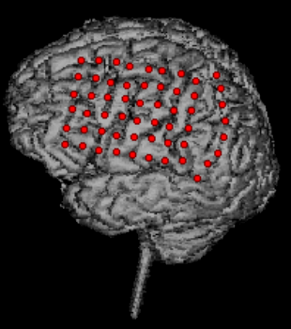
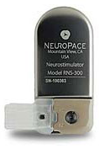
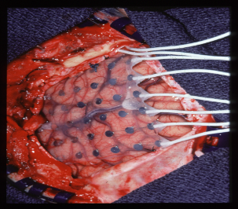
A Community in Need of Data Integration: Neuroscience
Neuroscience had little history of data sharing!
Each group independently collects, then “mines” its repository of data
No comparative benchmarking, almost no collaboration
Clear needs, e.g., in building implantable devices and algorithms for epilepsy
NO SHARING: Perception of personal risk and effort, with little reward, in sharing!!
NO USING: No history so few neuroscientists look for others’ data

Slide 11
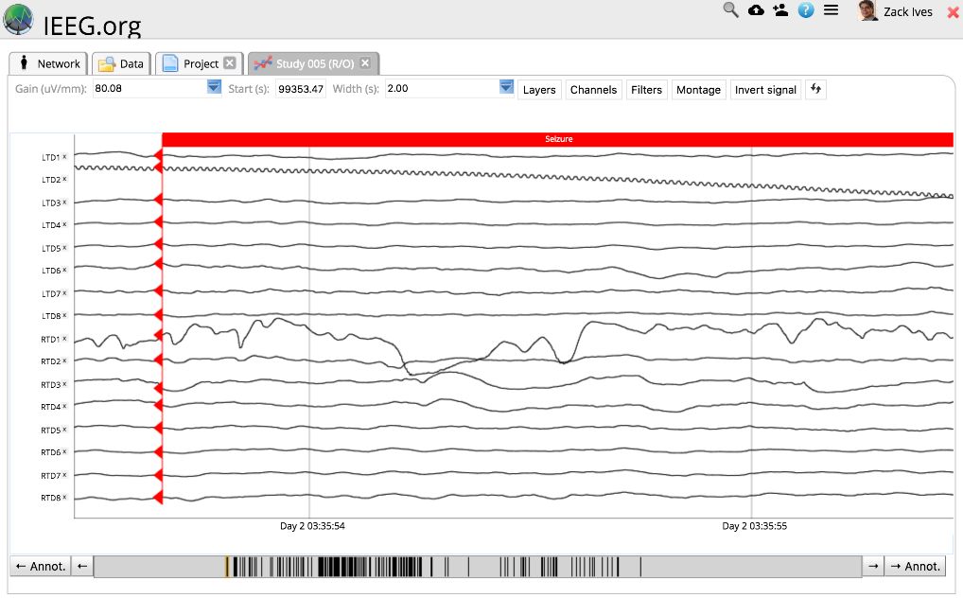
Making Data Sharing for Epilepsy Easy: IEEG.org [w/Litt, Wagenaar, Worrell]
Integrate, host epilepsy ECoG data → seizure prediction algorithms, devices
“No excuses about the difficulty of sharing”
Use the cloud – upload, convert, manage, and view EEG data
Converted all data into a common schema
Interfaces to Matlab, common tools
2500 datasets from academia and industry
Still a challenge: Users didn’t look for us! Providers argued there was no impact!
Funded by NIH NINDS

Slide 12
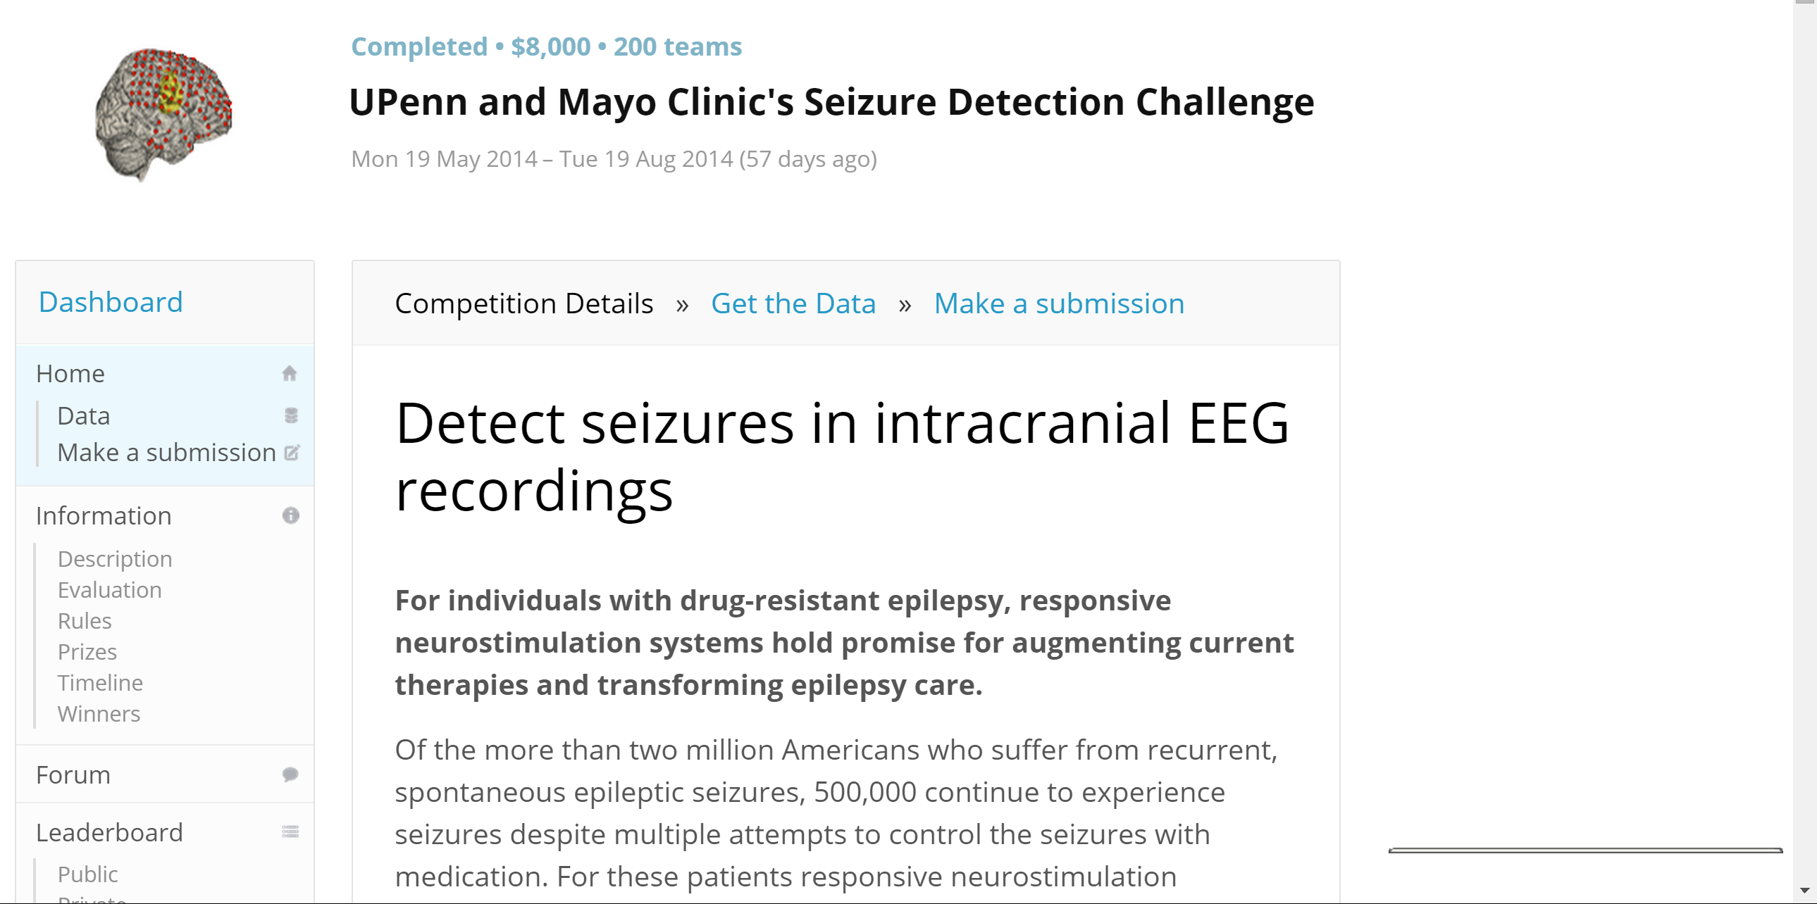
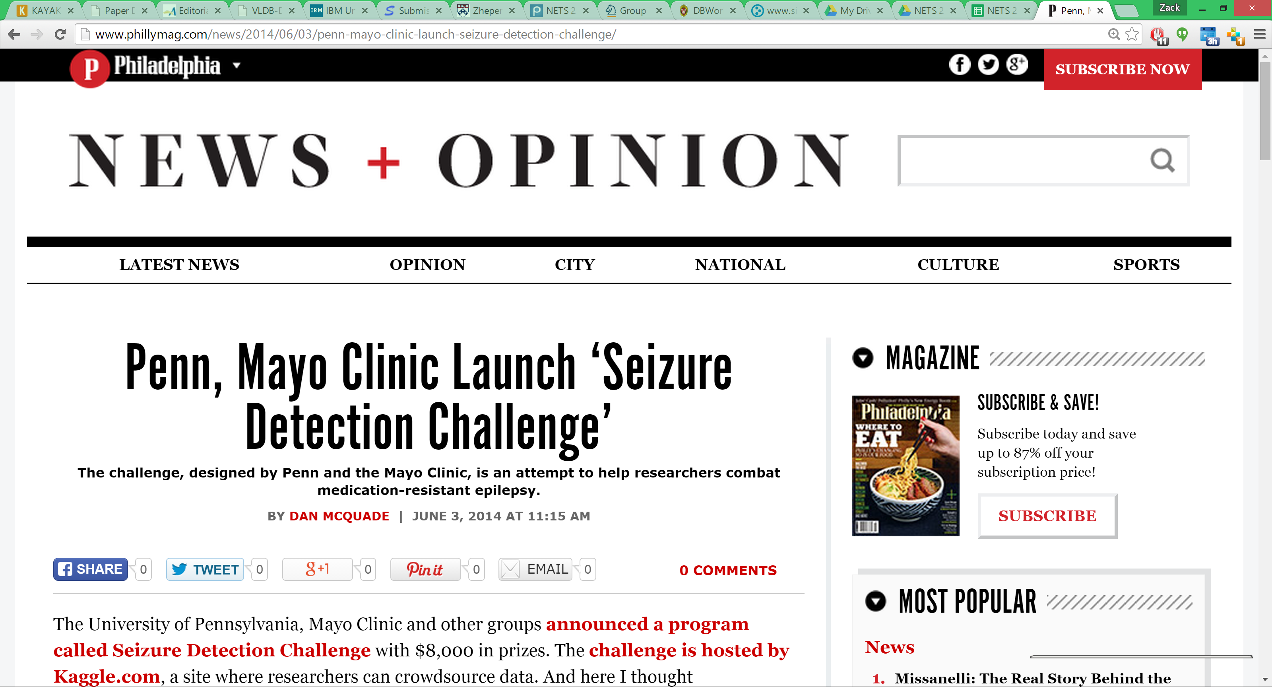
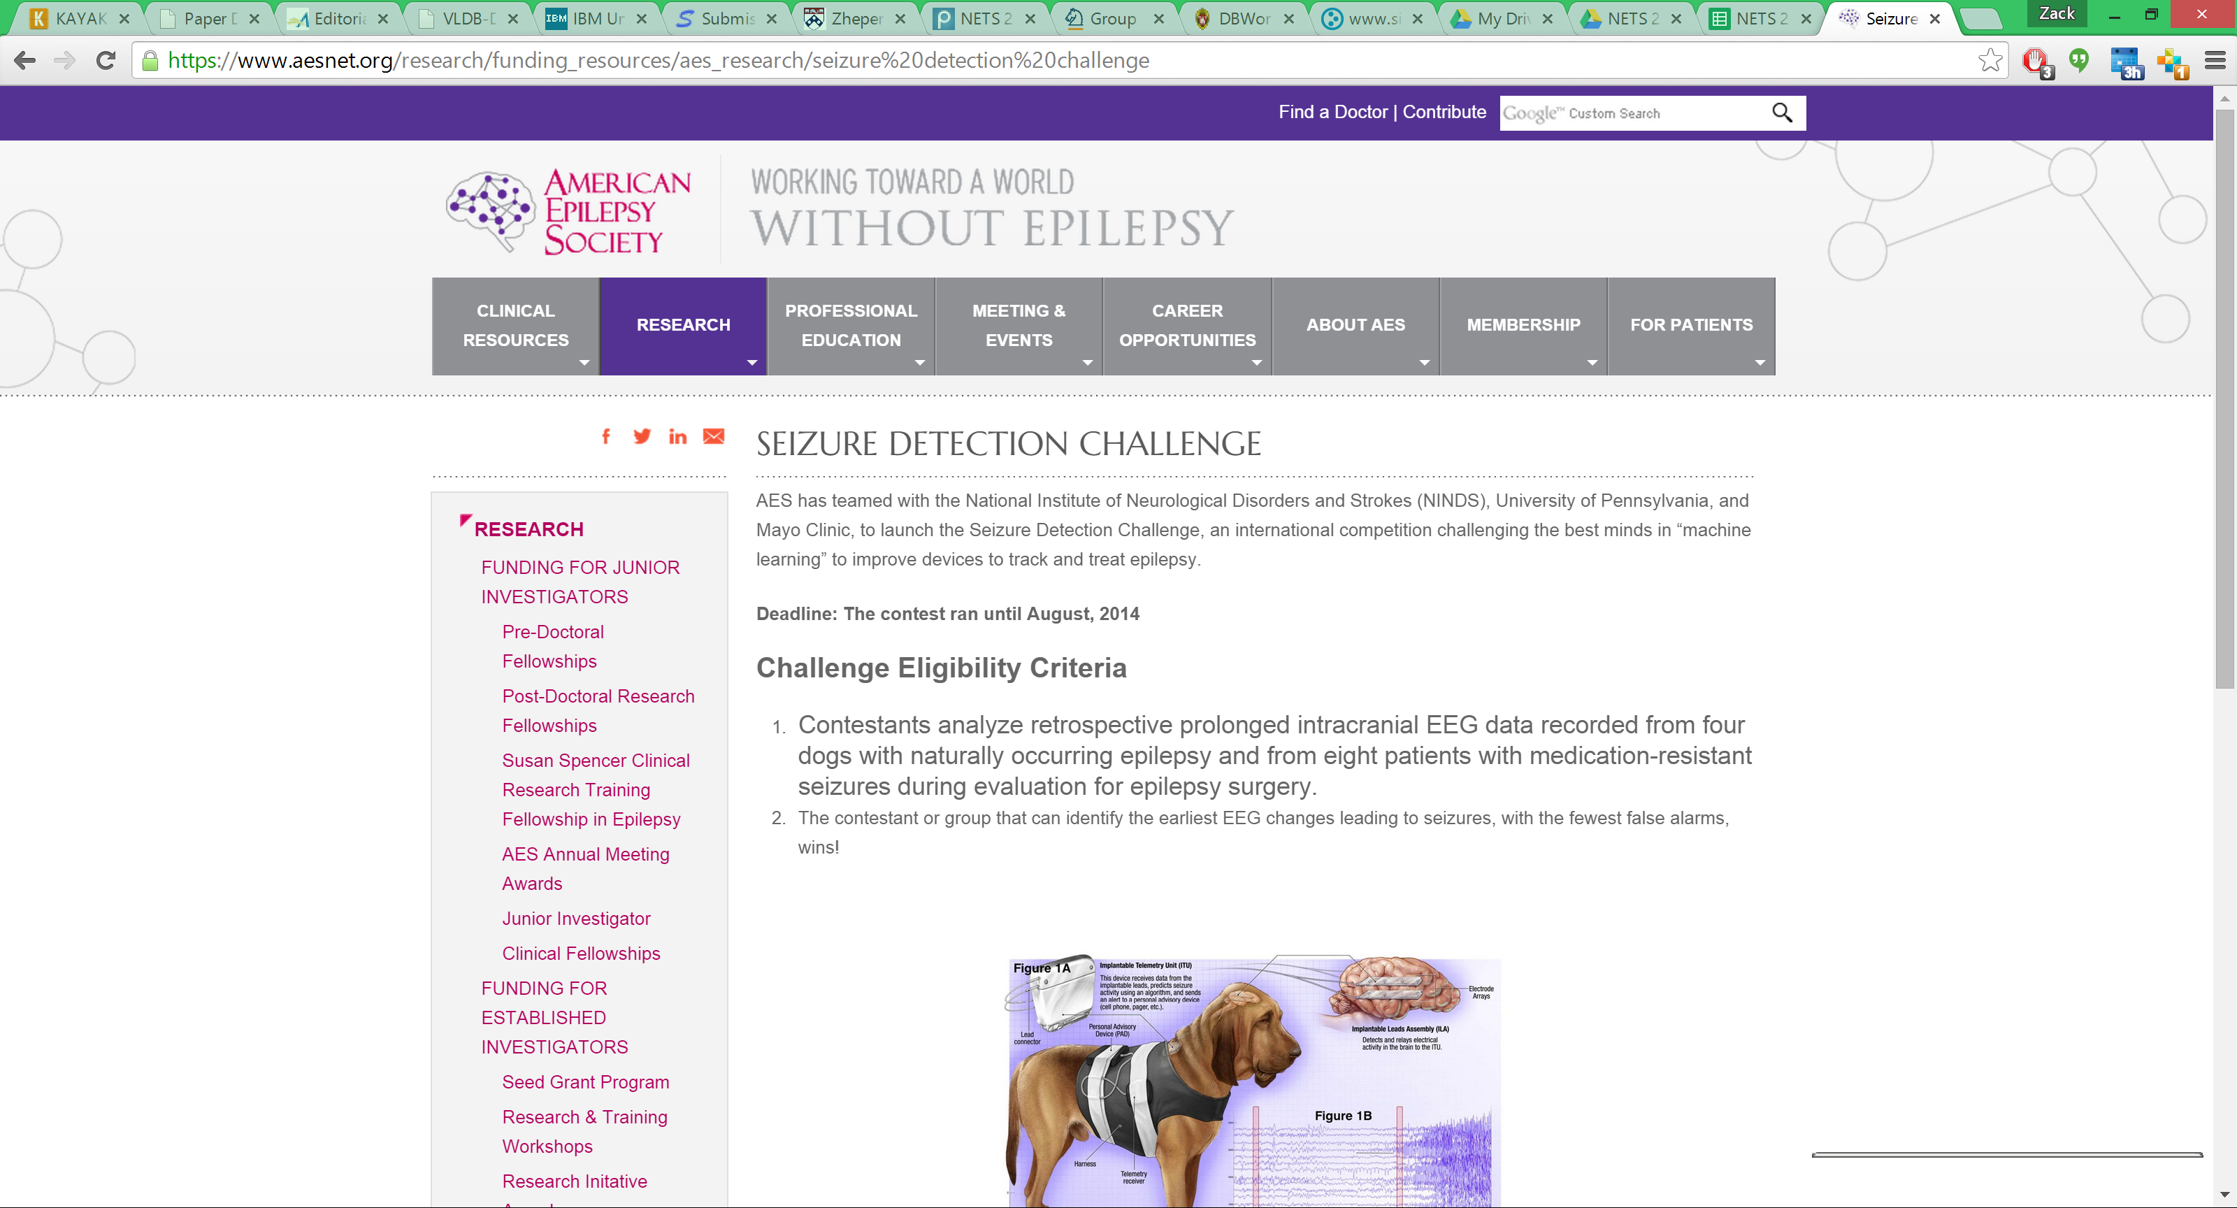
Solution: Challenges & Prizes
Highlight the epilepsy problem for non-neuroscientists!
Formulate data, problems, evaluation in a way that other data scientists could work on problems!
Seizure detection, seizure prediction challenges via Kaggle.com competition site
Detection: $8K in prizes, 200 teams, 96% detection
Prediction: $25K prizes, 504 teams, 85% prediction; better than any published work!

Slide 13
Lessons Learned in Phase I
Ramping was difficult given limited academic resources – can’t get users until the whole ecosystem is in place
Tremendous growth (1500+ users, 20+ institutions, multiple companies) once momentum was achieved – with demonstrated success

Slide 14
But there Were Irritating Technical Issues
It’s too expensive to integrate new data manually
Human data (data + patient case history + electrode configuration)
Then dog data (no case history but different metadata)
Then wearable sensor data
Then video data annotated with behaviors
Etc.
Telling every user “we can take your data in 6 months for ¼ a programmer” isn’t viable
How do we do this to scale, in a way that isn’t domain-specific?
Data integration for the “open world”…

Slide 15
Phase 2: Towards a Common Platform for the Core of Data Science
Q System (research project) → Blackfynn Platform

Slide 16
The Key Divergence from Common Practice
Most efforts start by assuming the first step is to clean and standardize all of the data
Once the data is all clean, we can reuse what we know
This works in the enterprise – “closed world”
The reality – it’s impossible for an evolving field
New data requires new extensions and redefinitions in our model of the world
Lots of data will be dirty – or only usable under certain conditions
So can we instead build a platform that lets us evolve the data as needed?

Slide 17
The Vision: “Pay as You Go Integration” [Halevy et al. 2003]
Can we build an environment to manage data sharing “in situ”?
Link (don’t move) any data into the system
Use whatever tools we have to link, “semantify,” (and later search) the data
Over time, users (and new algorithms, and machine learning) will help integrate and improve the data
Let users reverse and repair mistakes through data provenance
A vision that has been around for some time – the challenge has been how to implement it!

Slide 18
First Step: Drag and Drop any Data into a Probabilistic Graph Database [CIDR 13]
My.NIFTI
Known concepts, types, and data
instance_of
My.NIFTI
date
extent
9-26-16
Extractable fields
coregisteredTo
Data Extraction
Engine
pat001
Raw NIFTI object (file system)
Binary data

Slide 19
The Model: Search-Driven Integration [Talukdar+08,10] to Query and Refine the Graph
Upon upload:
Some fields from the file may map to common data elements
Some data may also link to existing data (or not)
Opportunistically (in background):
Add candidate links between data items, e.g., by running computational jobs to match identifiers (“record linking”) or to coregister across data modalities
Map the data to concepts in the ontology, semi-automatically or manually
Users help us improve the graph…
Fields and links have provenance – description of how and why they were created – and we can “revert” or “correct” changes
JSON
PDF

Slide 20
Users Are Focused on Relating Multi-Modal Data for Analysis, via Queries
Analytics (Python, Matlab, etc)
Entity | property1 | property2 | … | property3 | class
Subject1 | p11 | p21 | … | p31 | A
Subject2 | p12 | p22 | … | p32 | B
… |  |  | …
Subjectn | p1n | p2n | … | p3n | A
Query
Graph
JSON
PDF
EPIC
Data

Slide 21
What Kinds of Queries?
Main focus: “show me how X, Y, and Z might be related”
i.e., give me the most likely hypotheses about relationships
Or give me the most likely connections across our multi-modal data
The relationships might be heterogeneous – different connections for different datasets
We primarily drive this through keywords that match on data and metadata
(Can also have predicates on values)

Slide 22
Ranked Search Results
👍
👎
👍
🤔
👍
Users select items to include or exclude – this provides feedback and the system learns to fix mistakes

Slide 23
Technical Challenges
What has been missing:
Ability to probabilistically combine evidence from algorithms that semantically tag and link data:
fields that mean the same thing (“schema matching”) and objects from a class (“ontology alignment”)
Rows that represent the same entity (“record linking”)
co-registration of electrodes in images (another form of record linking)
These are all uncertain and output confidence scores (~ probabilities)
Ability to learn from and generalize what the user does with the results!
… Which algorithms to believe, and how much...

Slide 24
A Sketch of the Technical Approach
Q System (research project) → Blackfynn Platform

Slide 25
Searching & Linking on Demand
Query: “left temporal lobe epilepsy images with seizure markings”
Report
Dataset
EEG
Anno- tation
Terms
ds_id
text
...
ds_id
name
id
...
ch_id
ch_id
...
term
syn
12
seizure
marking
annotation
001
left temporal …
Image
desc
...
im_id
Goal: find “explanations” about how the terms can be linked
May require us to add (probabilistic) connections to the graph!

Slide 26
Searching & Linking on Demand
Query: “left temporal lobe epilepsy images with seizure markings”
Report
Dataset
EEG
Anno- tation
Report
Dataset
EEG
Anno- tation
Terms
ds_id
text
...
ds_id
name
id
...
ch_id
ch_id
...
term
syn
Typically there are MANY possible answers…
... Each of which has some evidence as to its correctness ... But some of the answers may be incorrect or irrelevant...
We want to give the user our “best answers” but try to learn from our mistakes!
12
seizure
seizure
marking
annotation
marking
Image
001
left temporal …
Image
left temporal …
seizure
left temporal lobe epilepsy
marking
desc
...
im_id
images
Goal: find “explanations” about how the terms can be linked
May require us to add (probabilistic) connections to the graph!

Slide 27
Data and Links Have Features and Weights, Supporting Probabilities & Ranking
Nodes, links annotated with evidence for correctness – features (provenance):
We’ll learn weights for the features
Feature | f
hasDataFromS? | 1
hasDataFromT? | 1
linker1AboveThreshold? | 1
linker2AboveThreshold? | 0
w
0.8
0.7
0.5
0.3
S
T
linksTo
∙
= 0.8+0.7+0.5 = 2.0
Probabilistic scoring model (assuming independence) that supports learning:
for edge e: cost_{e} = -lg₂(P_{e})
We use this to rank results in decreasing order of probability!

Slide 28
Learning from Inclusion / Exclusion of Results [Talukdar+08,10][Yan+13]
End users probably can often assess plausibility of query results
Different results will share nodes, edges, and features – we can generalize
User feedback helps us learn source trustworthiness [Talukdar+08] and linking algorithm quality [Talukdar+10]
👍
👎
👍
🤔
👎
👍

Slide 29
Feedback Allows the System to Learn Good vs Bad Links [Talukdar+10][Yan+13]
Bioinformatics data, real user query “templates”, feedback based on gold-standard answers

Slide 30
Making It Useful – Commercial Platform
How can we make a reusable, general platform (with finite resources?)
Critical to understand what problems we are trying to solve, who the users are, make the experience intuitive
(I won’t claim we have the answers!)
Our strategy so far: partnerships with consortia trying to do multimodal data analytics for biomarker discovery
Many data modalities, some PHI – build as we need these
Emphasis on pluggable viewers, modules, tools, APIs, …
Facilitate teams with different expertise
Human annotation ➔ algorithms ➔ predictions and classifications
Could we be on the way towards some sort of “core” for biomedical data science?

Slide 31
Contributions and Ongoing Work
Have identified some basic requirements for enabling data science at scale:
Incentivizing participation and engagement
Framework for evolving data into integrated, curated form
Supply your own data
Supply your own linking algorithms
Users give feedback on answers, help refine, link, and map data
Still much more to do!
Much broader suite of data types, algorithms, … to see if learning can scale
Richer probabilistic models – first need more users and data!
Use provenance to improve users’ understanding of results
Prove that integration leads to discovery (success stories)!

Slide 32
Related Work
Alignment algorithms:
Rahm et al. (COMA++), Gal et al. (OntoBuilder and descendants)
Ilyas et al. (Nadeef), [Gruenheid+14], Mehrotra et al., …
Crowdsourcing: CrowdDB [Franklin, Kraska, …], Parameswaran, …
Compositional frameworks for learning mappings:
LSD, GLUE (Doan), COMA++ (Rahm), annual Ontology Alignment Challenge
Vision papers: Pay-as-you-go data integration (Halevy, Maier, Franklin, …)
Early pay-as-you-go papers [Dittrich+], [Belhajjame+]
Keyword search over structured data: BANKS, BLINKS, DISCOVER, XRANK, …

