Slide 1
Big Data Analyses: The Cancer Moonshot
Reynold A. Panettieri, Jr., M.D.
Professor of Medicine, Robert Wood Johnson Medical School
Vice Chancellor, Clinical & Translational Science
Director, Rutgers Institute for Translational Medicine & Science
Rutgers, The State University of New Jersey
New Brunswick, NJ

Slide 2
“Doctors have always recognized that every patient is unique, and doctors have always tried to tailor their treatments as best they can to individuals. You can match a blood transfusion to a blood type — that was an important discovery. What if matching a cancer cure to our genetic code was just as easy, just as standard? What if figuring out the right dose of medicine was as simple as taking our temperature?”
- President Obama, January 30, 2015

Slide 3
Precision Medicine Mission Statement:
To enable a new era of medicine through research, technology, and policies that empower patients, researchers, and providers to work together toward development of individualized care.

Slide 4
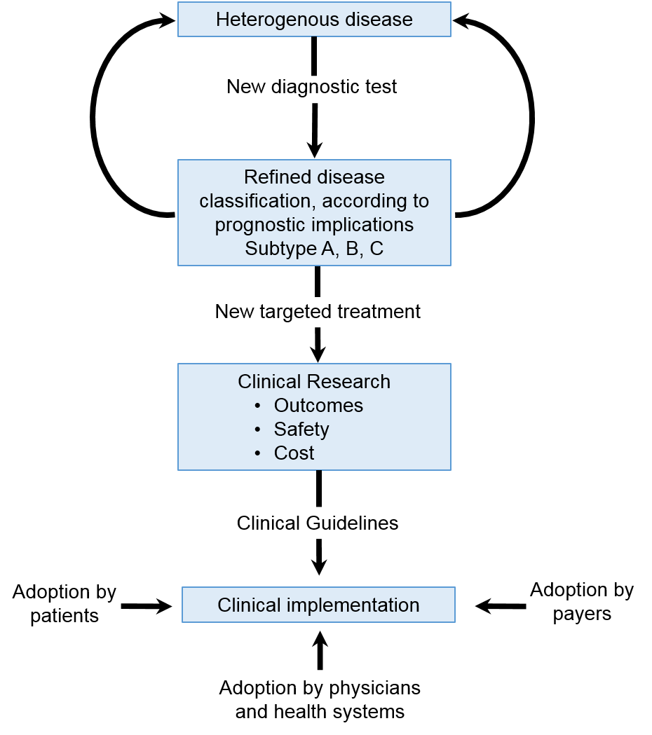
Heterogeneity in Disease and Response to Therapy
Jamison JL et al NEJM 2015

Slide 5
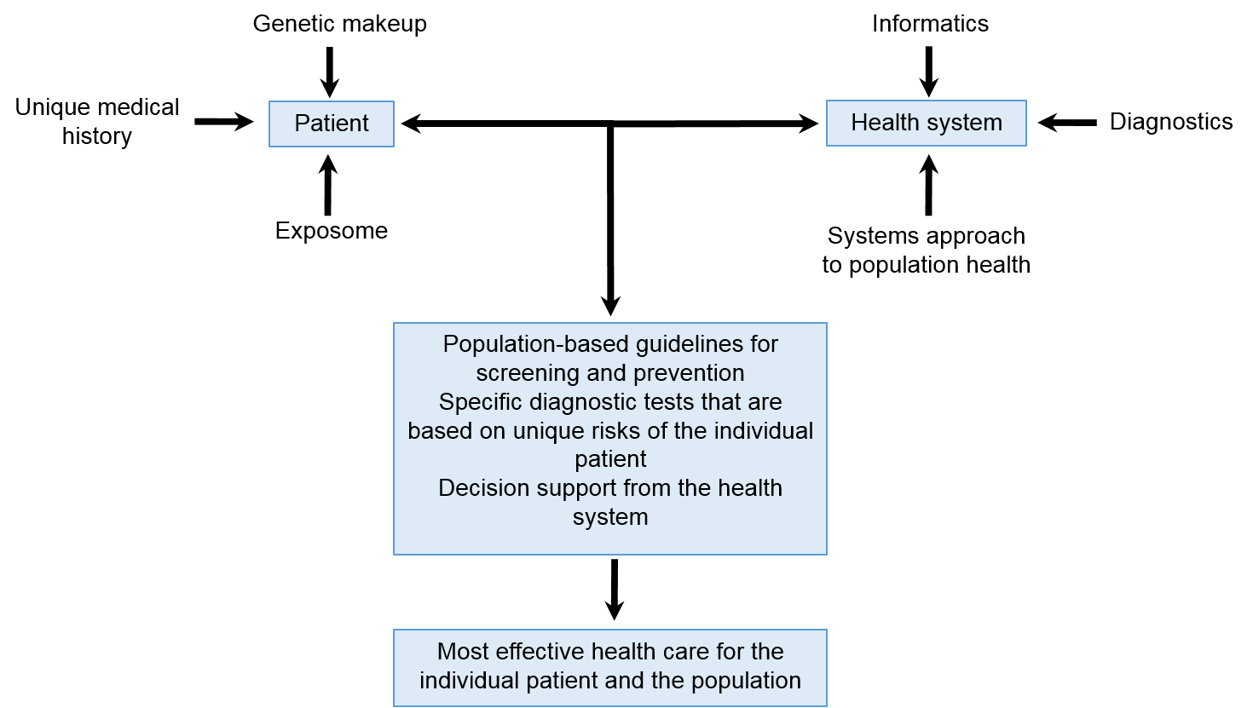
Heterogeneity in Disease and Response to Therapy
Jamison JL et al NEJM 2015

Slide 6
Examples of Precision Medicine Use
Medical Field Disease Biomarker Intervention
Cancer Chronic Myeloid Leukemia BCR-ABL Imatinib
Hematology Thrombosis Factor V Avoid
Leiden prothrombotics
Infectious disease HIV/AIDS CD4+ T cells Highly active
viral load antiretroviral
therapy
Cardiovascular disease CAD CYP2C19 Clopidogrel
Neurology Autoimmune
encephalitis CXCL13 Immunotherapy
Psychiatry Alcohol-use
disorder GRIK1 Topiramate
Pharmacogenomics Smoking cessation CYP2A6 Varenicline

Slide 7
Precision Medicine For Practitioners
The Right Diagnosis
The Right Patient
The Right Therapy
The Right Time
Institute for Translational
Medicine and Science
Paving the Way For Personalized Medicine. Food and Drug Administraition (FDA) Report. October 2013. http://www.fda.gov/downloads/ScienceResearch/SpecialTopics/PersonalizedMedicine/UCM372421.pdf. March 8, 2016

Slide 8
National Cancer Moonshot Initiative
The National Cancer Moonshot Initiative was established to accelerate cancer research, to make more therapies available to more patients, and to improve our ability to prevent cancer and detect it an early stage
Community input is critical to the success of the National Cancer Moonshot Initiative, and NIH is asking the community to submit their scientific ideas or suggestion for addressing cancer research challenges to cancerreseaarch@nih.gov (closes July 1)
The NCI Blue Ribbon Panel of experts will use the information submitted to help shape discussions on the cancer research priorities to be supported.
The FY2017 President’s budge request includes $680 million of additional funding for NCI to support the this national cancer research initiative and a $260.5 million increase in NCI funding in its FY2016 appropriation
Institute for Translational
Medicine and Science

Slide 9
Cancer Moonshot: Panel Recommendations
Establish a network for direct patient involvement.
Create a clinical trials network devoted exclusively to immunotherapy.
Develop ways to overcome cancer’s resistance to therapy.
Build a national cancer data ecosystem.
Intensify research on the major drivers of childhood cancers.
Minimize cancer treatment’s debilitating side effects.
Expand use of proven cancer prevention and early detection strategies.
Mine past patient data to predict future patient outcomes.
Develop a 3-D cancer atlas.
Develop new cancer technologies
Updated from NCI: September 7, 2016

Slide 10
Cancer Moonshot: Discussions
Big data analyses provide impressive promissory notes. Will these analyses provide cost effective platforms to improve precision medicine approaches in cancer?
Challenges exist in addressing missing information and double counting participant data. If there exists no master list of participants/subjects/patients, what approaches are most valued in addressing such concerns related to cancer?
Updated from NCI: September 7, 2016

Slide 11
Cancer Moonshot: Discussions (cont)
3. How may a health provider organization initiate studies if there exists no data warehouse for their data? What are the personnel and hardware needs if one wants to initiate such studies?
4. Centralized consenting is important to protect PHI (Protected Health Information). How do investigators, institutions, payers and government address the use of legacy data in cancer, especially if the subject/participant is deceased or inaccessible?
Updated from NCI: September 7, 2016

