Slide 1
Keyword Search on Structured and Semi-Structured Data
Yi Chen
Wei Wang
Ziyang Liu
Xuemin Lin
Arizona State University, USA
University of New South Wales & NICTA, Australia
Notes:
2009/7/15
Dr. Wei Wang @ CSE, UNSW
1

Slide 2

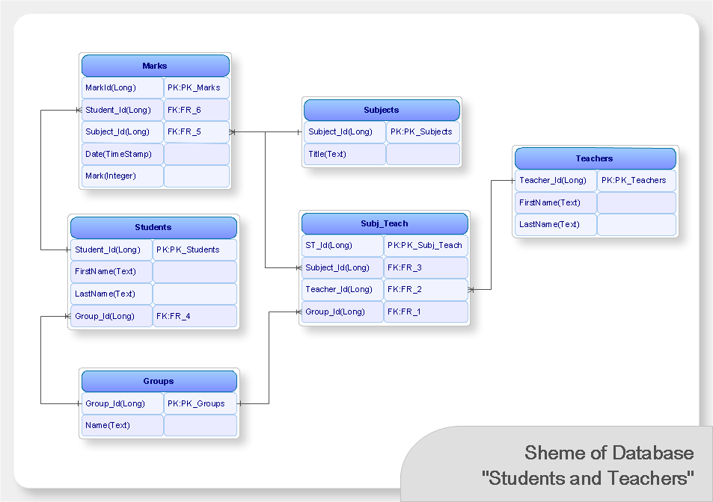




Traditional Data Access Methods
Text documents:
  Unstructured
  Accessed by keywords
  Limited search quality
  Large user population
Databases / XML data
  Structured, with rich meta-data
  Accessed by query languages
  High search quality
  Small user population that masters DB

Slide 3


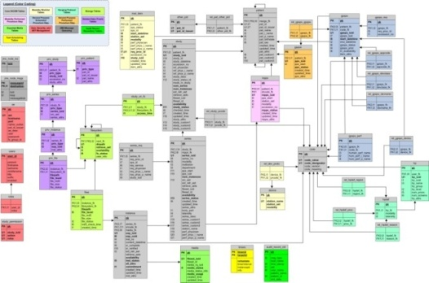
The Challenges of Accessing Structured Data
Query languages: long learning curves
Schemas: Complex, evolving, or even unavailable.
What about filling in query forms?
  Limited access pattern.
  Hard to design and maintain forms on dynamic and heterogeneous data!
select paper.title from conference c, paper p, author a1, author a2, write w1, write w2 where c.cid = p.cid AND p.pid = w1.pid AND p.pid = w2.pid AND w1.aid = a1.aid AND w2.aid = a2.aid AND a1.name = “John” AND a2.name = “Mary” AND c.name = SIGMOD
The usability of DB is severely limited unless easier ways to access databases are developed ^{[Jagadish, SIGMOD 07]}.

Slide 4


Supporting Keyword Search on DB – Advantages /1
  Easy to use
    The most important factor for the majority of users.
    The same advantage of keyword search on text documents

Slide 5

Supporting Keyword Search on DB – Advantages /2
  Enabling interesting or unexpected discoveries
    Relevant data pieces that are scattered but are collectively relevant to the query should be automatically assembled in the results
    Larger scope for data inter-connection
Seltzer, Berkeley
Is Seltzer a student at UC Berkeley?
Seltzer is a developer of Berkeley DB.
Wow.

Slide 6
Supporting Keyword Search on DB – Advantages /3
  Returning meaningful results by exploiting structural information.
  An unique opportunity in structured data
Query: “Bernstein, skyline”
Structured Document
Text Document
Such a result will have a low rank.
“Bernstein is a computer scientist.......... One of Bernstein’s colleagues, Duane, recently published a paper about skyline query processing.”
scientist
scientist
name
publications
name
publications
Bernstein
paper
Duane
paper
title
title
model management
skyline

Slide 7



Supporting Keyword Search on DB – Summary of Advantages
  Increasing the DB usability
  Increasing the coverage and quality of keyword search

Slide 8
Supporting Keyword Search on DB – Challenges /1
Semantics: keyword queries are ambiguous
  How to infer the query semantics and find relevant answers?
  How to effectively rank the results in the order of their relevance?
  How to help users analyze results?
  How to evaluate the quality of search results?

Slide 9
Supporting Keyword Search on DB – Challenges /2
  Efficiency:
  Many problems in keyword search on DB are shown to be NP-hard.
    Generating results, query segmentation, snippet generation, etc.,
  Large datasets
  How to generate (top-k) query results efficiently?

Slide 10
Keyword Search on DB: State-of-the Art
Keyword search on DB has become a hot research direction, and attracted researchers in DB, IR, theory, etc
  More than 50 research papers, from both research labs and universities in major database conferences/journals
  Workshop about keyword search on DB (KEYS, June 28, 09)
and counting...

Slide 11
Timeline /1
2003
2004
2005
2006
2007
2008
2009
XKeyword
MLCA
SLCA
Tree
proximity
XSeek
MaxMatch
XReal
XML
XSEarch
SLCA 2
eXtract
RTF
XRank
CVLCA
ELCA
WISE
Nested Graphs
/Workflows

Slide 12
Timeline /2
Before 2002
2002
2003-2005
2006
2007
2008
2009
Proximity
Search
BANKS
1
Discover
2
Preis
SPARK
BANKS
3
Community
RDBMS/ Graph
Result Generation
Information
Unit
DBXplorer
BANKS
2
D&C
BLINKS
SUITS
RDMBS
Discover
DP
Hetero-
geneous
EASE
IR
Ranking
KDAP
QUnit
Form
Search
RDBMS/ Graph
Other Applications
DB
selection 1
SQAK
Frequent
terms
DB
Selection 2
Data
Clouds
Query
Cleaning
Minimal
Group-by

Slide 13
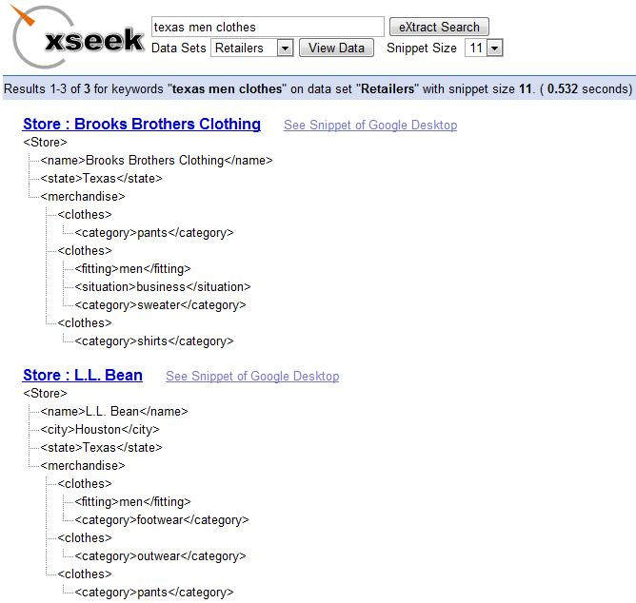
XSeek Demo
http://xseek.asu.edu/

Slide 14
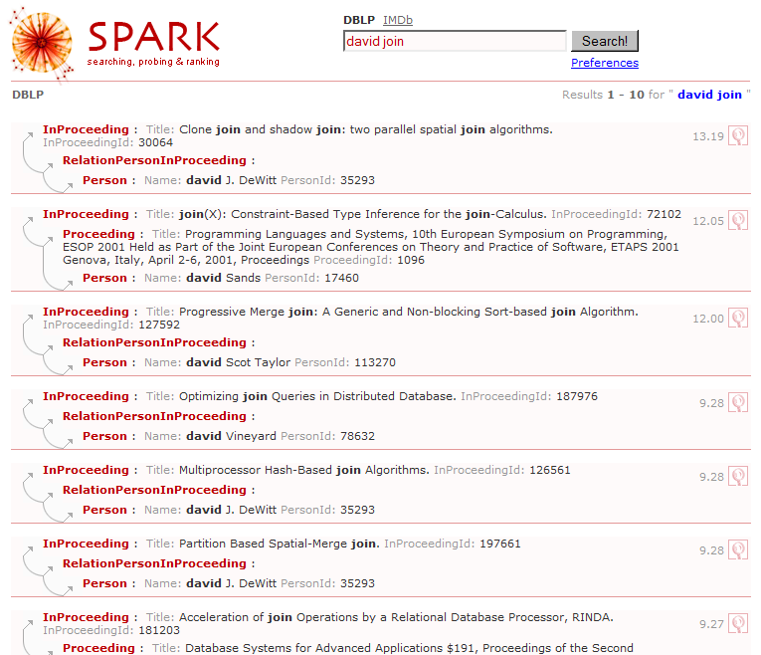
SPARK Demo /1
http://www.cse.unsw.edu.au/~weiw/project/SPARKdemo.html
After seeing the query results, the user identifies that ‘david’ should be ‘david J. Dewitt’.

Slide 15
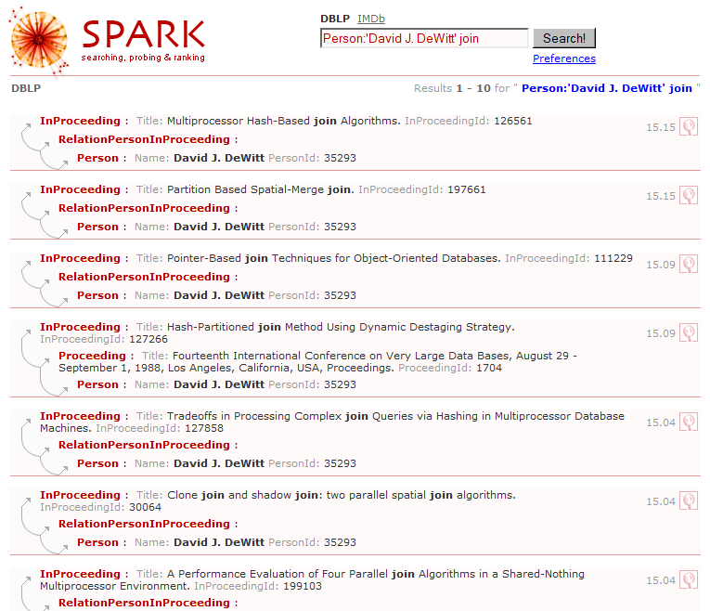
SPARK Demo /2
The user is only interested in finding all join papers written by David J. Dewitt (i.e., not the 4th result)

Slide 16
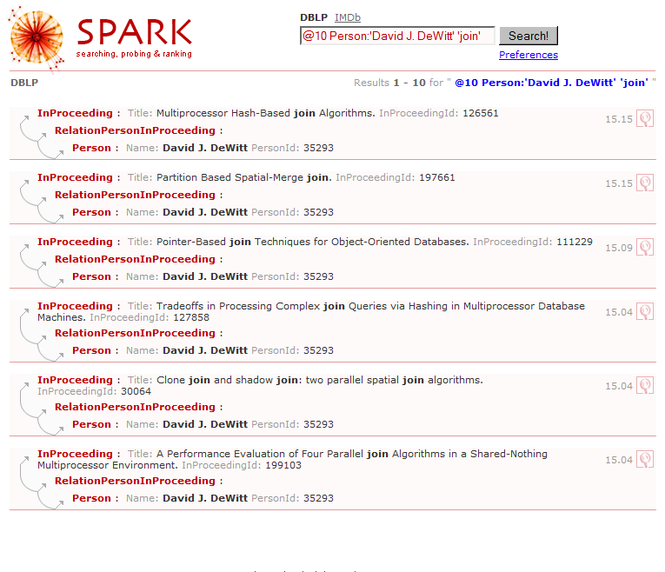
SPARK Demo /3

Slide 17
Overview of This Tutorial
Outline the problem space and review typical approaches
  Data Models: Trees, Graphs, Nested Graphs, Distributed Data
  Problem Space:
Discuss future directions
Post-processing
Pre-processing
Query Processing
Result Snippets
Result Clustering
Result Analysis/Evaluation
Database Selection
Result Generation
Ranking
Query Cleaning

Slide 18
Roadmap
Motivation and Challenges
Query Result Definition and Algorithms
  Trees
  Nested Graphs
  Graphs
  RDBMS
Ranking
Query Preprocessing
Result Analysis and Evaluation
Searching Distributed Databases
Future Research Directions
Part 1
Part 2

Slide 19
Result Definitions
Input:
  Data: DB, XML, Web, Nested Graphs, etc.
  Query Q = <k₁, k₂, ..., k_{l}>
Output: “closely related” nodes that are “collectively relevant” to the query
  The smallest trees covering all keywords.
 | DB | XML | Web | Nested Graph
Node | tuple | element /attribute | webpage | object
Edge | foreign key | parent/ child | hyper-link | expansion / dataflow

Slide 20
Result Definition on XML & Trees /1
In an XML tree, every two nodes are connected through their LCA.
Not all connected trees are relevant, even if the size is small.
The focus is defining query results to prune irrelevant subtrees.
conf
“Mark, title”
name
year
paper
paper
demo
SIGMOD
2007
title
author
author
…
title
author
author
title
author
keyword
name
name
XML
name
name
Top-k
name
Mark
Yang
Liu
Chen
Soliman

Slide 21
Result Definition on XML & Trees /2
Typical approaches of result definition: pruning irrelevant matches based on
  Tree structure: SLCA, ELCA, MLCA
  Labels/Tags: XSEarch, CVLCA
  Peer node comparisons: MaxMatch

Slide 22
Result Definition based on Tree Structure:
SLCA^{[Xu et al. SIGMOD 05]}& MLCA ^{[Li et al. VLDB 04]}
2-keyword queries
  The shorter the distance b/w two nodes, the closer their relationship
  For Q=(K₁, K₂), with matches (M₁₁, M₁₂, M₂)
  If the LCA (M₁₁, M₂) is a descendant of LCA (M₁₂, M₂), then M₁₁ is “strictly closer” to M₂ than M₁₂
conf
“paper, Mark”
name
year
paper
paper
demo
SIGMOD
2007
title
author
author
…
title
author
author
title
author
keyword
name
name
XML
name
name
Top-k
name
Mark
Yang
Liu
Chen
Soliman

Slide 23
SLCA^{[Xu et al. SIGMOD 05]}& MLCA ^{[Li et al. VLDB 04]}
3+-keyword queries:
  SLCA: finding the subtrees with no proper subtree containing all keywords.
  MLCA: finding a set of nodes, every pair is “closest”.
conf
“SIGMOD, paper, Mark”
name
year
paper
paper
demo
SIGMOD
2007
title
author
author
…
title
author
author
title
author
keyword
name
name
XML
name
name
Top-k
name
Mark
Yang
Liu
Chen
Soliman
SLCA is a superset of MLCA.

Slide 24
Result Definition based on Labels:
XSEarch ^{[Cohen et al. VLDB 03]}
2-keyword queries:
  Two nodes are interconnected if there’s no two nodes with the same label on their path.
  Intuitions: nodes with two same labels on their path are usually unrelated.
“paper, mark”
conf
name
year
paper
paper
demo
SIGMOD
2007
title
author
author
…
title
author
author
title
author
keyword
name
name
XML
name
name
Top-k
name
Mark
Yang
Liu
Chen
Soliman

Slide 25
MLCA vs. XSEarch
MLCA and XSEarch use different inference of node relationships, and hence different results.
conf
name
year
paper
paper
demo
SIGMOD
2007
title
author
author
…
title
author
author
title
author
keyword
name
name
XML
name
name
Top-k
name
Mark
Yang
Liu
Chen
Soliman
Interconnected, not closest
Closest, not interconnected.

Slide 26
XSEarch ^{[Cohen et al. VLDB 03]}
3+-keyword queries:
  All-pair Semantics: every two keyword matches in a result are interconnected (MLCA also uses all-pair semantics)
“SIGMOD, paper, Mark”
conf
name
year
paper
paper
demo
SIGMOD
2007
title
author
author
…
title
author
author
title
author
keyword
name
name
XML
name
name
Top-k
name
Mark
Yang
Liu
Chen
Soliman

Slide 27
XSEarch ^{[Cohen et al. VLDB 03]}
3+-keyword queries:
  Star Semantics: each result has a “star” node, such that every other node is interconnected with it.
“SIGMOD, paper, Mark”
conf
name
year
paper
paper
demo
SIGMOD
2007
title
author
author
…
title
author
author
title
author
keyword
name
name
XML
name
name
Top-k
name
Mark
Yang
Liu
Chen
Soliman
Relevant matches in Star semantics is a superset of those in all-pair semantics

Slide 28
Result Definition based on Peer Node Comparison:
MaxMatch ^{[Liu et al. VLDB 08]}
Intuition: pruning nodes with stronger siblings
“SIGMOD, paper, Mark”
conf
name
year
paper
paper
demo
SIGMOD
2007
title
author
author
…
title
author
author
title
author
keyword
name
name
XML
name
name
Top-k
name
Mark
Yang
Liu
Chen
Soliman

Slide 29
Other Result Semantics on XML
XReal [Bao et al. ICDE 09]
  Inferring node types for result roots using data statistics
  A result root node should
    Be relevant to all keywords
    Neither too low or too high
Relaxed Tightest Fragments [Kong et al. EDBT 09]
  An improvement of XSEarch aiming at reducing false negatives.

Slide 30
Result Quality Evaluation
Given various heuristics, which approach will have a better search quality?
Stay tuned, our talk later will discuss evaluation metrics
  Empirical benchmark
  Axiomatic framework

Slide 31
Efficiency
Achieving all these semantics take polynomial time.
  SLCA: O(S_{min}kdlogS_{max})
    Multi-way SLCA ^{[Sun et al. WWW 07]} further improves the efficiency.
Materialized views are proposed for further speedup of computing SLCA ^{[Liu et al. ICDE 08 (poster)]}
  Results can be efficiently computed from materialized views of subqueries.
Nodes are usually encoded using Dewey labels.

Slide 32
Roadmap
Motivation and Challenges
Query Result Definition and Algorithms
  Trees: Finding relevant matches; Finding relevant non-matches
  Nested Graphs
  Graphs
  RDBMS
Ranking
Query Preprocessing
Result Analysis and Evaluation
Searching Distributed Databases
Future Research Directions

Slide 33
Relevant Non-matches /1 ^{[Liu et al. SIGMOD 07]}
Besides keyword matches and the paths connecting them, other nodes may also be interested to the user.
Q1: “SIGMOD, Beijing”
Q2: “SIGMOD, location”
conf
name
year
location
paper
paper
demo
SIGMOD
2007
Beijing
title
author
author
…
title
author
author
title
author
keyword
name
name
XML
name
name
Top-k
name
Mark
Yang
Liu
Chen
Soliman
Similar relevant matches, different query semantics, and thus should have different query results

Slide 34
Relevant Non-matches /2 ^{[Liu et al. SIGMOD 07]}
Similar as XQuery, Keywords can specify predicates or return nodes.
  Q1: “SIGMOD, Beijing”
  Q2: “SIGMOD, location”
Return nodes may also be implicit.
  Q1: “SIGMOD, Beijing” → return node = “conf”
Information (subtree) of return nodes are potentially interesting, and considered as relevant non-matches.

Slide 35
Relevant Non-matches /3 ^{[Liu et al. SIGMOD 07]}
Explicit return nodes: analyzing keyword match patterns
Implicit return nodes: analyzing data semantics (entity, attribute) [Kimelfeld et al. SIGMOD 09 (demo)]
Q2: “SIGMOD, location”
Q1: “SIGMOD, Beijing”
conf
name
year
location
paper
paper
demo
SIGMOD
2007
Beijing
title
author
author
…
title
author
author
title
author
keyword
name
name
XML
name
name
Top-k
name
Mark
Yang
Liu
Chen
Soliman

Slide 36
Roadmap
Motivation and Challenges
Query Result Definition and Algorithms
  Trees
  Nested Graphs
  Graphs
  RDBMS
Ranking
Query Preprocessing
Result Analysis and Evaluation
Searching Distributed Databases
Future Research Directions

Slide 37
Searching Nested Graphs /1 ^{[Shao et al. ICDE 09 (demo)]}
Multi-resolution data are used in workflows, spatial and temporal data.
Workflows are widely used in scientific, business domains as well as in daily life.
curry chicken
expansion edge (across layers)
dataflow edge (within one layer)
make chicken broth
cook chicken
serve
preprocess chicken
make rice pilaf
……
tenderize chicken breast
concoct
slice
add chicken broth
cook and stir until solid
stir in flour
add green pepper & onion
add coconut milk
put into skillet
saute until tender

Slide 38
Searching Nested Graphs /2 ^{[Shao et al. ICDE 09 (demo)]}
Approaches for keyword search on graphs/trees (i.e. finding minimal trees) are not desirable
preprocess chicken
cook chicken
“chicken breast, coconut milk, saute”
add coconut milk
tenderize chicken
breast
concoct
saute until
tender
Not Informative: dataflows between tasks are lost.
  do not capture the different semantics of edges in workflows
Not self-contained: nodes in the result do not accomplish a task/goal.
Challenge: how to define desirable query results on nested graphs?

Slide 39
Roadmap
Motivation and Challenges
Query Result Definition and Algorithms
  Trees
  Nested Graphs
  Graphs
  RDBMS
Ranking
Query Preprocessing
Result Analysis and Evaluation
Searching Distributed Databases
Future Research Directions

Slide 40
Result Definitions for Graphs
Input:
  Query Q = <k₁, k₂, ..., k_{l}>
Outputs are “closely related” objects that are “collectively relevant” to the query
  Graph Schema-free
  RDBMS Schema-based
Scoring/ranking methods
  To be covered in Sec 3.

Slide 41
Evolution of Query Result Definitions
Schema-free
Group Steiner Tree (GST)
  Dynamic Programming or Mixed Integer Programming
  Lawler’s framework
Approximate Group Steiner Tree
  BANKS 1/2/3, BLINKS O(l)-approximation to 1-GST
    STAR ^{[Kasneci et al, ICDE09]} O(log l)-approximation 1-GST
  Distinct root semantics
Subgraph-based
  Community
  EASE

Slide 42
Closely Related Nodes
k1
a
5
6
6
b
Obtaining the graph
  From DB, XML, Web, RDF, etc.
  (Un)directed (weighted) graph G = < V, E, w>
  Matching/keyword nodes
If only two keywords
  Shortest path !
  k-shortest paths
k2
2
2
c
d
a – c : 6
a
c

Slide 43
Group Steiner Tree
k1
a
5
6
7
b
Steine nodes
b
Steiner Tree
  A connected tree in G that spans a set of node S_{i}
  S_{i} are collectively relevant to the query
Group Steiner Tree ^{[Li et al, WWW01]}
  Spanning from one node from each group
top-1 GST = top-1 ST
  ☒NP-hard ☑Tractable for fixed l
k2
2
3
k3
c
d
GST
a (c, d): 13
a(b(c, d)): 10
ST
a
5
6
7
1M
b
2
3
c
d
1M
1M
k1
k2
k3

Slide 44
Dynamic Programming for GST-1 ^{[Ding et al, ICDE07]}
k1
a
Recurrence equations
  T(n, Q) = 0
  T(v, Q) = min(T_{g}(v, Q) , T_{m}(v, Q))
  T_{g}(v, Q) = min_{(v,u)∈E} ((v, u) ⊕ T(u, Q))
  Tm(v, Q) = min_{Q1⊆Q} (T(v, Q1) ⊕ T(v, Q \ Q1))
5
6
7
b
k2
2
3
k3
c
d
a (c, d): 13
a(b(c, d)): 10
T(a, 123) = min(T_{g}(a, 123) , T_{m}(a, 123))
T_{g}(a, 123) = min(5+T(b, 23), 6+T(c, 23), 7+T(d, 23))
T_{m}(a, 123) = min(T(a, 12)+T(a, 3),
T(a, 13)+T(a, 2), T(a, 23)+T(a, 1))

Slide 45
DP for GST-k
Keep running GST-1 until k results are obtained ➔ approximate answer
Complexities (GST-1, GST-k)
  Time: O(3^{l}n + 2^{l}((l+logn)n + m)) O(nlogn + m)
  Space: O(2^{l}n) O(n)
If l=O(1)

Slide 46
From top-1 to top-k Exactly
Lawler’s Framework ^{[Lawler, 1972]}
  Discrete optimization problem ➔ Enumeration problem
  Input
    A way to partition the solution space
    An algorithm to find top-1 solution in a (constraint) solution space
  Output
    Top-k solution in the entire solution space (with good running time properties)
  c.f. ^{[Cohen, et al. ICDE09]} tutorial

Slide 47
Finding top-k GST ^{[Kimelfeld et al, PODS06]}
Idea
  Steiner tree can be found efficiently for fixed number of keywords
  Apply Lawler’s framework
    Intricate technical details to find solution under inclusion constraints
Algorithm:
  Q.enqueue(ST(G))
  While Q not empty
    <T, I, E> = Q.dequeue()
    {e₁, …, e_{k}} = edges(T) \ I
    Generate k partitions (E’ = e_{k-i}, I’ = {e₁, …, e_{i}}) and Queue.enqueue(CST(G), I’, E’)

Slide 48
Illustration
Top-2 (global)
P1
e1
e2
Top-1 (local): 4
Top-1 (global)
e1
e3
P2
e2
e1
e3
Top-1 (local): 5
Sol
yes
has e1?
no
P3
e3
has e2?
yes
no
P3
e2
has e3?
no
yes
no
P2
Top-1
P1
Top-1 (local): 4

Slide 49
MIP ^{[Talukdar et al, VLDB08]}
Top-1 Steiner Tree
  Mixed Linear Programming (MIP) to find the minimum Steiner Tree rooted at r
    Can also solve a constrained version of the problem
  Call this procedure for each node r in the graph
Applying Lawler’s framework to obtain top-k Steiner Trees
Approximate solutions for larger graph
  Reduce G to G’, where only m shortest paths between every pair of keyword nodes are kept

Slide 50
Approximate GST-k
BANKS1 ^{[Bhalotia et al, ICDE02]}
  Result definition: Group Steiner Trees
Approximate ST-ks using STs
  a backward expansion search algorithm
  Run multiple Dijkstra’s single-source-shortest-path algorithms iteratively until k answers are found ➔ equi-distance expansion
No guarantee on the quality of its top-k results

Slide 51
Example
P1 is the root of a ST wrt (k1, k2)
and it might be ST-1
P1
P1
P2
A: Author
W: Writes
P: Paper
W1
W2
W3
A1
A2
k1
k2
S₁
S₂
While (!quit)
  Execute the iterator, I_{j} , whose output node, v_{j}, has the least “distance” from its source
  v_{j}.reachable_from[label(I_{j})] ∪= source(I_{j})
  If v is reachable from at least one source in every S_{i}
    OutputHeap << GenResult(v_{j})
// result = Π(reachable sources)
// current best result emitted when heap is full

Slide 52
BANKS2 ^{[Kacholia et al, VLDB05]}
k1
a
Distinct root semantics
  Find trees rooted at r s.t it minimizes
  cost(T_{r}) = ∑_{i} cost(r, match_{i})
  A tree ➔ a set of paths
Why?
  Fits into backward expansion search algorithms (BANKS1) perfectly
  Favors trees with small radii
Algorithmic ideas:
  bi-directional search + activation mechanism
5
6
7
b
k2
2
3
k3
c
d
a (c, d): 13
a(b(c, d)): 10
{aa, ab, ad}
0+7+8

Slide 53
Example
k2
k1
k1
k1
…
P1
P98
P99
P100
P101
P500
…
…
…
…
W1
W98
W99
W100
W101
…
A1
A2
k1
Initialize activation values, data structure for backward & forward iterators
While (!quit)
  Explore the nodes with the highest activation value (consider both iterators)
  Spread the activation to its neighbors
  Update the min dist from v to each of the search terms (and other data structures)

Slide 54
Proximity Search ^{[Goldman et al, VLDB98]}
G
Distinct root semantics
Foreach root candidates r_{i}
  Cost(r_{i}) = Cost(r_{i}, k1) + Cost(r_{i}, k2)
  Keep only the top-k min cost roots

Slide 55
Proximity Search ^{[Goldman et al, VLDB98]}
G
k_{i} is not known a priori
Distinct root semantics
Foreach root candidates r_{i}
  Cost(r_{i}) = Cost(r_{i}, k1) + Cost(r_{i}, k2)
  Keep only the top-k min cost roots
2 Choices:
Index node-node distance, or
Index node-keyword distance

Slide 56
Indexing Node-Node Min Distance
H
O(|V|²) space is impractical
Select hub nodes (H_{i})
  d*(u, v) records min distance between u and v without crossing any H_{i}
Using the Hub Index
y
x
d(x, y) = min (d*(x, y), d*(x, A) + d^{H}(A, B) + d*(B, y), ∀A, B ∈H )

Slide 57
SLINKS /1 ^{[He et al, SIGMOD07]}
G
Distinct root semantics
Foreach root candidates r_{i}
  Cost(r_{i}) = Cost(r_{i}, k1) + Cost(r_{i}, k2)
  Keep only the top-k min cost roots
Index node-keyword distance
Use Fagin’s TA Alg.

Slide 58
SLINKS /2
r_{i}
d1=5
d2=6
d1’=3
r_{j}
d2’ =9
Formulate it as a top-k problem
  Each candidate root r_{i} has l attributes d₁, d₂, …, d_{l}
    D_{j} = d(r_{i}, k_{j})
  Score(r_{i}) = r_{i}.d₁ + r_{i}.d₂ + … + r_{i}.d_{l}
Input: for each d_{j}, sort r_{i} in increasing order
Threshold Algorithm (TA)
  While (less than k results)
    Visit the next r from d_{i}’s list (round-robin)
    Find r’s missing d_{i} values, if any
    Maintain score lower bound, etc.
r | d1 | d2
ri | 5 | 6
rj | 3 | 9
// backward expansion using index
// forward expansion using index
// book-keeping

Slide 59
SLINKS ➔ BLINKS
r_{i}
d1=5
d2=6
d1’=3
r_{j}
d2’ =9
SLINKS requires backward + forward indexes
  Between nodes and keywords
  Thus O(K*|V|) space ≈ O(|V|²) in practice
BLINKS
  Partition the graph into blocks
    Portal nodes shared by blocks
  Build intra-block, inter-block, and keyword-to-block indexes

Slide 60
Other Related Methods
GST and its approximation
  Information Unit [Li et al, WWW01]
    Growing a forest of MSTs (minimum spanning trees)
  BANKS3 [Dalvi et al, VLDB08]
    Use graph clustering to handle external graphs
Distinct root semantics
  [Tran et al, ICDE09]
    Considers more complex ranking functions

Slide 61
Community ^{[Qin et al, ICDE09]}
center
Steiner nodes
r_{i}
Redundancy affects
  Distinct root semantics
  GST
Community | R_{max}
  Idea: GROUP BY (unique keyword nodes combinations)
core
…
i.e., the set of core nodes

Slide 62
Community-finding Algorithms
Nested loop
  Enumerate core node combinations
Bottom-up search
  BANKS 2, BLINKS (using index)
Top-down search
  Proximity search (using index)
Polynormial delay enumeration
  Backward search to find the best root
  Partition the solution space and apply Lawler’s method

Slide 63
Example
a
x
k2
k1
b
Solution space
y
2 partitions generated
  ( b, ¬y)
  (¬b, *)
c
c
b |  | ✓
a
 | x | y

Slide 64
EASE /1 ^{[Li et al, SIGMOD08]}
a
Redundancy affects
  GST
  Distinct root semantics
  Community
Subgraphs as results | r
x
k2
k1
b
y
c

Slide 65
EASE /2
r-Radius graph (r-G) ➔ r-Radius Steiner graph (r-SG), given Q
  By removing useless nodes
  Also introduced maximal r-G/r-SG
Keyword query results are x-SGs that contain all/some the search keywords (x ≤ r)
Index (keyword pair ➔ (maximal r-Gs, sim))
  sim is used to compute the final score
TA-style algorithm to find top-k r-SGs

Slide 66
Roadmap
Motivation and Challenges
Query Result Definition and Algorithms
  Trees
  Nested Graphs
  Graphs
  RDBMS
Ranking
Query Preprocessing
Result Analysis and Evaluation
Searching Distributed Databases
Future Research Directions

Slide 67
Keyword Search for RDBMSs
Schema-based
Running example
  Author(aid, name)
  Paper(pid, title)
  Writes(aid, pid)
Keyword queries as query interpretation
  “Widom XML”
  “XML Trio”
Schema Graph:
Author ⬅ Writes ➔ Paper
σ_{”widom”}(A) W  σ_{”xml”}(P)
σ_{”xml”}(P) W  A  W  σ_{”trio”}(P)
σ_{”trio”}(A) W  σ_{”xml”}(P), …
Candidate Network (CN)
A^{trio} – W – P^{xml}
What if “trio” is also a person’s name?

Slide 68
Why CNs?
X
X
V
U
5
5
5
a
x
7
7
Y
Advantages
  Query driven
  Compensate for normalization
  Perspectives
Differences with graph-based approaches
  Reflect one’s prior belief
    Précis ^{[Koutrika et al, ICDE06]}, Recommending CN ^{[Yang et al, ICDE09]}, Interconnection Semantics ^{[Cohen and Sagiv, ICDT05],} Disambiguation: SUITS ^{[Zhou et al, 2007]}
  Can leverage IR/other ranking principles
    [Liu et al, SIGMOD06], SPARK [Yi et al, SIGMOD07]
U – X – X – V | 0
U – X – Y – V | 19

Slide 69
DISCOVER ^{[Hristidis et al, VLDB02]}
Consider enumerating all the necessary CNs
  up to a size limit T_{max}
  Minimum set of join expressions to execute
  allow multiple occurrence of a relation as cmp’ed with DBXplorer ^{[Agrawal et al, ICDE02]}
T_{max} = 3
nonfree tuple set
A^{Q}
P^{Q}
A^{Q} – W – P^{Q}
free tuple set

Slide 70
Query Processing
Construct non-free tuple sets
  Via inverted index
Generate all the valid CNs
  Breadth-first enumeration on the database schema graph
  + pruning
Rewrite the list of CNs into an execution schedule
  Usually top-k retrieval
  Most algorithms differ here

Slide 71
Generating CNs
Schema Graph: A^{Q} ⬅ W ➔ P^{Q}
1 | A^{Q}
2 | P^{Q}
Not minimal
3 | A^{Q} – W
Input
  non-free tuple sets
Output
  all valid CNs no larger than T_{max}
Method
  Breadth-first search + pruning
4 | W – P^{Q}
Non-promising
5 | A^{Q} – W A^{Q}
6 | W – P^{Q} P^{Q}
… | ...
9 | A^{Q} – W – P^{Q}
… | ...
12 | A^{Q} – W – P^{Q} A^{Q} – W
13 | W – P^{Q} A^{Q} – W – P^{Q}
… | ...
71

Slide 72
DISCOVER2 ^{[Hristidis et al, VLDB03]}
Construct non-free tuple sets
Generate all the valid CNs
Execution algorithms optimized for top-k queries
  Naïve → Sparse → Single pipelined/Global pipelined
Push top-k constraints inside !

Slide 73
Naive
top-2
CN1
P^{Q} – W – A^{Q}
CN2
P^{Q} – W – A – W – P^{Q}
Naive
  Retrieve top-k results from each CN
    ORDER BY + LIMIT
  Merge them to obtain top-k query result
  Can be optimized to share computation
Result (CN1) | Score
P1-W1-A2 | 3.0
P2-W5-A3 | 2.3
... | ...
Result (CN2) | Score
P2-W2-A1-W3-P7 | 1.0
P2-W9-A5-W6-P8 | 0.6
... | ...
SELECT * FROM P, W, A
WHERE P.pid = W.pid AND P.aid = A.aid
AND P.title MATCHES ‘xml, trio’
AND A.name MATCHES ‘xml, trio’
ORDER BY score_p + score_a
LIMIT 2;

Slide 74
Naive ➔ Sparse
top-2
CN1
P^{Q} – W – A^{Q}
Result (CN1) | Score
P1-W1-A2 | 3.0
P2-W5-A3 | 2.3
... | ...
Sparse
  Execute 1 CN at a time
    start from the smallest CNs
  Prune the rest of the CNs using the current top-k score & MPSs of the remaining CNs.
CN2
P^{Q} – W – A – W – P^{Q}
Result (CN2) | Score
P1-W?-A?-W?-P1 | 1.5
Best case scenario
Max Possible Score
score(P1 – … – P1)
≥ score(Px – … – Py)
(x>1, y>1)
No need to execute CN2 !
Requires “score monotonicity”

Slide 75
Pipelined /1
top-2
CN1
P^{Q} – W – A^{Q}
Result (CN1) | Score
P1-W1-A2 | 3.0
P2-W5-A3 | 2.3
... | ...
Motivation
  What if join result >> k ?
Top-k optimization within a CN
MPS(P3 – W? – [A1, A2]) = (1.8+1.2) /3 = 1.0
MPS([P1, P2] – W? –A3) = (3.3+0.9) /3 = 1.4
≤ 0.8
...
A4
A3
A2 | ✗ | ✗
A1 | ✗ | ✗
 | P1 | P2 | P3 | ...
0.8
SELECT * FROM P, W, A
WHERE P.pid = W.pid AND P.aid = A.aid
AND P.pid in (P1, P2)
AND A.pid = A3
0.9
1.7
1.8
3.3
2.7
1.2
≤ 1.2

Slide 76
Pipelined /2
top-2
CN1
P^{Q} – W – A^{Q}
Motivation
  What if join result >> k ?
Top-k optimization within a CN
MPS(P3 – W? – [A1, A2]) = (1.8+1.2) /3 = 1.0
MPS([P1, P2] – W? –A3) = (3.3+0.9) /3 = 1.4
≤ 0.3
...
A4 | ≤1.2 | ≤1.2
A3 | 1.4 | 1.2 | ≤1.0
A2 | ✗ | ✗ | ≤1.0
A1 | ✗ | ✗ | ≤1.0
 | P1 | P2 | P3 | ...
0.3
Result (CN1) | Score
P1-W8-A3 | 1.4
P2-W9-A3 | 1.2
... | ...
0.9
1.7
1.8
Can we stop?
3.3
2.7
1.2
≤ 1.2
MPS([P1, P2] – W? –A4) = (3.3+0.3) /3 = 1.2

Slide 77
Global Pipelined
Naive ➔ Sparse ➔ Pipelined
Be lazy!
Utilize upper bound estimates
Run Pipelined on each CN in an interleaving way
  Determined by CN’s MPS
Get_MPS()
Next()
Get_MPS()
Next()
Pipelined
Pipelined
CN1
P^{Q} – W – A^{Q}
CN2
P^{Q} – W – A – W – P^{Q}
top-2

Slide 78
SPARK
^{[Luo et al, SIGMOD07]}
top-2
CN1
P^{Q} – W – A^{Q}
Temp Results | Score
P2-W7-A2 | 1.47
Motivation
  What if (# of red cells) >> k ?
Skyline Sweeping
  Perform 1 probe each time
  Push “neighbors” to a heap based on their MPSs
MPS(P2 – W? –A3) = 1.2
MPS(P3 – W? –A2) = 0.97
≤ 0.8
...
A4
A3
A2 | ✗ | ✗
A1 | ✗ | ✗
 | P1 | P2 | P3 | ...
≤ 0.8
...
A4
A3 | 1.2
A2 | ✗ | ?
A1 | ✗ | ✗ | 1.0
 | P1 | P2 | P3 | ...
0.8
0.8
0.9
0.9
?
1.7
1.7
1.47
?
1.8
1.8
3.3
2.7
1.2
≤ 1.2
3.3
2.7
1.2
≤ 1.2

Slide 79
Block Pipeline
CN1
P^{Q} – W – A^{Q}
Motivation
  What if “score monotonicity” does not hold?
Ideas
  Find salient orderings s.t. we can derive a global score upper bounding function
  Partition the search space into blocks s.t there is a tighter upper bounding function for each block
…
...
A4
A1
A2
A3
 | P1 | P3 | P2 | ...
k2
0.8
k1
1.8
1.7
k1,k2
0.9
3.3
1.2
2.7
…
k1,k2
k1

Slide 80
Using Semi-joins
Qin et al, “Keyword Search in Databases: The Power of RDBMS”, SIGMOD 2009
  Tomorrow morning
  Research Session 18: Keyword Search

Slide 81
Comparing Result Definitions
Using schema?
Differences between def’s
  Bias
  Computational complexity
  Redundancy
k1
a
 | Schema-based | Schema-free
RDBMS | CN
Graph |  | (Group) Steiner Tree, Distinct root semantics, Subgraph
XML | XSEarch, Entities, … | LCA and its variants
5
6
7
b
k2
2
3
k3
c
d
a
b
c
d
a
b
d
c

Slide 82
Summary of Result Definition and Algorithms
We have discussed result definition and query processing on three data models
  Trees
  Graphs
  Nested Graphs
The basis of query result is minimum Group Steiner tree, and later other variants (suitable in different data models)

Slide 83
Roadmap
Motivation and Challenges
Query Result Definition and Algorithms
Ranking
Query Preprocessing
Result Analysis and Evaluation
Search Distributed Databases
Future Research Directions

Slide 84
Ranking Schemes
Ranking is important for keyword search
  On the Web
  On databases
Illustrate existing ranking schemes
  Simple ➔ IR-based + other factors considered

Slide 85
Proximity /1
Total proximity
  Group Steiner tree
Proximity to root/center
  Distinct root semantics

Slide 86
Proximity /2
Proximity between keyword nodes
  EASE:
  XRank:
    w is the smallest text window in n that contains all search keywords

Slide 87
Assigning Node Weights /1
Based on graph structure
  BANKS
    Nodes:
    Edges :
  PageRank-like methods
    XRank ^{[Guo et al, SIGMOD03]}
    ObjectRank ^{[Balmin et al, VLDB04]} : considers both Global ObjectRank and Keyword-specific ObjectRank

Slide 88
Assigning Node Weights /2
TF*IDF based:
  Discover/EASE
  [Liu et al, SIGMOD06]
  SPARK
    but not at the node level

Slide 89
Score Aggregate Function
Combine s(node_{i}) into a final score for ranking
  BANKS: agg(edge) * agg(node)^{λ}
  DISCOVER: ∑_{n} s(n) / size_normalization
  [Liu et al, SIGMOD06]:
Problem
  Raw tf values are not well attenuated
1.2
0.5
3.8
same
score?
1.2
0.5
3.8

Slide 90
Holistic Ranking
SPARK
  Each results in a CN is deemed as a virtual document
  Calculate tf and idf on the virtual document level
1.2
0.5
3.8
1.2
0.5
3.8

Slide 91
CN Scores
Prefer small results
  Discover 2
  [Liu et al, SIGMOD06]
  SPARK
  Prune CNs
    By experts, query log, materialized views
    Constraints: Précis, Interconnection semantics

Slide 92
Completeness Factor
SPARK
  Tune between AND- and OR- semantics
  Based on Extended Boolean Model: Measure Lp distance to the idea position
SUITS:
k1
d = 1
Ideal Pos
(1,1)
d = 0.5
d = 1.41
k2
L₂ distance

Slide 93
Roadmap
Motivation and Challenges
Query Result Definition and Algorithms
Ranking
Query Preprocessing
Result Analysis and Evaluation
Search Distributed Databases
Future Research Directions

Slide 94
Query Cleaning ^{[Pu et al, VLDB08]}
new york time price
Motivations
  Query may contain typos
  Query may contain phrases
  Speed up query processing
Input
  A keyword query
  Database
Output
  Corrected and segmented query
… new york …
… account …
price
≈O(3^{l}n) DP alg
…happy time …
… new york times…
new york times
price

Slide 95
Cleaning Algorithm
new york time price
Cleaning Algorithm
  Expand each token into possible variants and construct a candidate space
  Find an optimal segmentation that maximizes a segmentation score (error-aware)
    A dynamic programming algorithm for the static case; also incremental version of the DP algorithm
new york time price
new
york time price
new york
time price
new
york times
price
new york times
price
Also relevant: Query autocompletion [Li et al, SIGMOD09, Chaudhuri et al, SIGMOD09]

Slide 96
Roadmap
Motivation and Challenges
Query Result Definition and Algorithms
Ranking
Query Preprocessing
Result Analysis and Evaluation
  Result Snippets
  Mining Interesting Terms
  Table Analysis
  Result Evaluation
Search Distributed Databases
Future Research Directions

Slide 97
Result Analysis / Evaluation
Result Snippets
  Complement ranking schemes and help user pick relevant results quickly.
Mining Interesting Terms
  Help user formulate new queries.
Table Analysis
  Finding tuple clusters that are relevant to a keyword query.
Result Evaluation
  A useful guide for users to pick the most desirable search engine.

Slide 98
Result Snippets on XML ^{[Huang et al. SIGMOD 08]}
conf
Q: “Sigmod, conf”
From the snippets, we know
  The two results are about “SIGMOD 06” and “SIGMOD 07”.
  Feature different hot topics and different institution / countries that have significant contribution.
What are good snippets?
How to generate them?
name
year
paper
paper
paper
SIGMOD
2006
author
title
title
author
aff.
country
network
database
aff.
Microsoft
USA
NUS
conf
name
year
paper
paper
SIGMOD
2007
title
author
author
title
keyword
aff.
aff.
country
database
HKUST
Microsoft
USA

Slide 99
Distinguishable Snippets ^{[Huang et al. SIGMOD 08]}
Q: “Sigmod, conf”
return entity
support entity
conf
What is the key of an XML search result?
Two types of entities:
  Return entities
  Support entities
Key of a query result = keys of return entities
name
year
paper
…
paper
SIGMOD
2007
title
author
title
author
keyword
name
aff.
country
XML
name
…
author
Yang
HKUST
China
Liu
name
aff.
country
Mark
HKUST
China
IList: a ranked list of information items to be included in snippets
Adding keywords, and the key of the query result to IList.
IList: SIGMOD, conf, 2007

Slide 100
Representative Snippets ^{[Huang et al. SIGMOD 08]}
conf
statistics
Author: country: USA: 84
Author: country: China: 17
Author: country: Singapore: 7
Paper: title: database: 21
Paper: title: keyword: 6
Paper: title: ranking: 3
Author: aff.: Microsoft: 35
Author: aff.: HKUST: 9
paper
…
name
year
paper
title
SIGMOD
2007
author
title
author
keyword
name
aff.
country
XML
name
…
author
Yang
HKUST
China
Liu
name
aff.
country
Feature Type
Mark
HKUST
China
Feature: (entity, attribute, value)
  e.g., (paper, title, XML)
Dominant features: features that have more occurrences than the other features of the same type.
Adding the dominant features of query result to IList
IList: SIGMOD, conf, 2007, USA, Microsoft, database, keyword, HKUST

Slide 101
Result Snippets on XML ^{[Huang et al. SIGMOD 08]}
Small snippet:
  Goal: selecting data instances, such that as many items in IList can be included in the snippet as possible with a size bound.
  NP-hard.
  Heuristic algorithms are proposed .

Slide 102
Roadmap
Motivation and Challenges
Query Result Definition and Algorithms
Ranking
Query Preprocessing
Result Analysis and Evaluation
  Result Snippets
  Mining Interesting Terms
  Table Analysis
  Result Evaluation
Search Distributed Databases
Future Research Directions

Slide 103
Mining Interesting Terms [Tao et al. EDBT 09, Koutrika et al. EDBT 09]
Snippets: generated for each individual result to help users choose most relevant ones.
Mining Interesting Terms: returning interesting non-keyword terms in all query results, to help user better understand the results and issue new queries.
  For query “art” on a course database, it is helpful to return the interesting words that are related to “art”.
    E.g., “Performance”, “Renaissance”, “Byzantine”

Slide 104
Data Cloud ^{[Koutrika et al. EDBT 09]}
Input: Query and results
Output: Top-k ranked non-keyword terms in the results.
Terms in results are ranked by several factors
    Term frequency
    Inverse Document Frequency
    Rank of the result in which a term appears

Slide 105
Frequent Co-occurring Terms^{[Tao et al. EDBT 09]}
  Can we avoid generating all results first?
Input: Query
Output: Top-k ranked non-keyword terms in the results.
  Capable of computing top-k terms efficiently without even generating results.
Terms in results are ranked by frequency.
  Tradeoff of quality and efficiency.

Slide 106
Roadmap
Motivation and Challenges
Query Result Definition and Algorithms
Ranking
Query Preprocessing
Result Analysis and Evaluation
  Result Snippets
  Mining Interesting Terms
  Table Analysis
  Result Evaluation
Search Distributed Databases
Future Research Directions

Slide 107
Table Analysis^{[Zhou et al. EDBT 09]}
In some application scenarios, a user may be interested in a group of tuples jointly matching a set of query keywords.
Given a keyword query with a set of specified attributes,
  Cluster tuples based on (subsets) of specified attributes so that each cluster has all keywords covered
  Output results by clusters, along with the shared specified attribute values

Slide 108
Table Analysis ^{[Zhou et al. EDBT 09]}
Input:
  Keywords: “pool, motorcycle, American food”
  Interesting attributes specified by the user: month state
Goal: cluster tuples so that each cluster has the same value of month and/or state and contains query keywords
Output
Month | State | City | Event | Description
Dec | TX | Houston | US Open Pool | Best of 19, ranking
Dec | TX | Dallas | Cowboy’s dream run | Motorcycle, beer
Dec | TX | Austin | SPAM Museum party | Classical American food
Oct | MI | Detroit | Motorcycle Rallies | Tournament, round robin
Oct | MI | Flint | Michigan Pool Exhibition | Non-ranking, 2 days
Sep | MI | Lansing | American Food history | The best food from USA
December Texas
*
Michigan

Slide 109
Roadmap
Motivation and Challenges
Query Result Definition and Algorithms
Ranking
Query Preprocessing
Result Analysis and Evaluation
  Result Snippets
  Mining Interesting Terms
  Table Analysis
  Result Evaluation: Empirical vs Formal
Search Distributed Databases
Future Research Directions

Slide 110
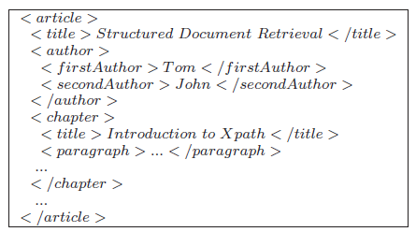
INEX - INitiative for the Evaluation of XML Retrieval
Benchmarks for DB: TPC, for IR: TREC
A large-scale campaign for the evaluation of document-oriented XML retrieval systems.
  Document oriented XML
Search quality is evaluated by large-scale user studies.
http://inex.is.informatik.uni-duisburg.de/

Slide 111
Axiomatic Framework
Formalize broad intuitions as a collection of simple axioms and evaluate strategies based on the axioms.
It has been successful in many areas, e.g. mathematical economics, clustering, location theory, collaborative filtering, etc

Slide 112
Axioms ^{[Liu et al. VLDB 08]}
Axioms for XML keyword search have been proposed for identifying relevant keyword matches
  Assuming “AND” semantics
  Some abnormal behaviors can be clearly observed when examining results of two similar queries or one query on two similar documents produced by the same search engine.
  Four axioms
    Data Monotonicity
    Query Monotonicity
    Data Consistency
    Query Consistency

Slide 113
Example: Query Monotonicity / Consistency
Q1: “paper, title”
Q2: “paper, title, Mark”
conf
name
year
paper
paper
demo
SIGMOD
2007
title
author
author
…
title
author
author
title
author
keyword
name
name
XML
name
name
Top-k
name
Mark
Yang
Liu
Chen
Soliman
Query Monotonicity: the # of query results does not increase after adding a query keyword.
Query Consistency: the new result subtree contains the new query keyword.

Slide 114
Example: Violation of Query Consistency
Q1: paper, Mark
conf
Q2: SIGMOD, paper, Mark
name
year
paper
paper
demo
SIGMOD
2007
title
author
author
…
title
author
author
title
author
keyword
name
name
XML
name
name
Top-k
name
Mark
Yang
Liu
Chen
Soliman
An XML keyword search engine that considers this subtree as relevant for the new query violates query consistency .
Query Consistency: the new result subtree contains the new query keyword.

Slide 115
Example: Data Consistency / Monotonicity
“paper, title”
conf
name
year
paper
paper
demo
SIGMOD
2007
title
author
author
…
title
author
author
title
author
keyword
name
name
XML
name
name
Top-k
name
Mark
Yang
Liu
Chen
Soliman
Data Monotonicity: the # of query results doesn’t decrease after inserting a new data node.
Data Consistency: each new result subtree contains the new data node.

Slide 116
Example: Violation of Data Monotonicity
“SIGMOD, Mark, Liu, title”
conf
name
year
paper
paper
demo
SIGMOD
2007
title
author
author
…
title
author
author
title
author
keyword
name
name
XML
name
name
Top-k
name
Mark
Yang
Liu
Chen
Soliman
An XML keyword search engine that outputs an empty result on the updated data violates data monotonicity.
Data Monotonicity: the # of query results doesn’t decrease after inserting a new data node.

Slide 117
    This set of axioms is non-trivial, but indeed satisfiable [Liu et al VLDB 08]

Slide 118
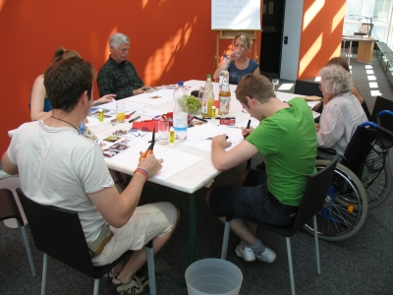
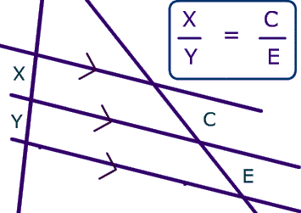
Empirical vs. Formal Evaluation
Benchmark
  The ultimate evaluation
  Costly – needs large data sets, query sets, and users.
Axioms
  Cost-effective
  Theoretical and objective
  Guiding the design
  Complement empirical studies

Slide 119
Roadmap
Motivation and Challenges
Query Result Definition and Algorithms
Ranking
Query Preprocessing
Result Analysis and Evaluation
Searching Distributed Databases
Future Research Directions

Slide 120

Database Selection ^{[Yu et al. SIGMOD 07]}
Input:
  a query
  multiple databases, each of which that can provide results to the query.
Output: names of databases that are likely to generate top-K results
Intuition: Pushing top-K query processing at database level
instead of issuing the query to all databases, only issue it to high-quality databases
?

Slide 121
Database Selection ^{[Yu et al. SIGMOD 07]}
Goal: Database score = sum score of top k results on this database
  Impossible to precisely evaluate w/o generating query results.
Approximation: database score = sum of score of top k connections of every pair of keywords
  Score of a connection = length of path
Algorithms are proposed to compute the relationship matrix between every two keywords in a database.

Slide 122
Kite ^{[Sayyadan et al. ICDE 07]}
Input:
  A query
  Multiple databases, each of which may NOT provide results to the query
Output: Results that contain all query keywords composed from multi-databases.
Intuition: Pushing keyword search from the level of multi- relations to multi-databases, where the relationships among databases can be discovered.

Slide 123
Kite ^{[Sayyadan et al. ICDE 07]}
Challenges:
  Automatically inferring meaningful joins across databases
  Supporting approximate/similarity joins

Slide 124
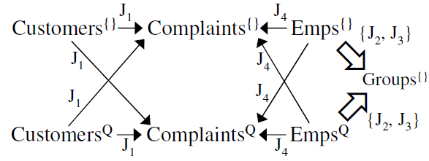
Kite ^{[Sayyadan et al. ICDE 07]}
Challenge: tables in multiple databases usually involve a large number of joins, making the number of CNs huge.
  Condense multiple relationships among two tables as one.
Lazily expand condensed CN when they are promising to provide top k results

Slide 125
Roadmap
Motivation and Challenges
Query Result Definition and Algorithms
Ranking
Query Preprocessing
Result Analysis and Evaluation
  Result Snippets
  Mining Interesting Terms
  Table Analysis
  Result Evaluation: Empirical vs Formal
Search Distributed Databases
Future Research Directions

Slide 126
Expressive Power vs. Complexity
Where is the right balance and how to achieve it?
Related work
  Supporting aggregate queries: KDAP ^{[Wu et al, SIGMOD07]}, SQAK ^{[Tata and Lohman, SIGMOD08]}
  Forms [Jayapandian and Jagadish, VLDB08], ^{[Chu et al, SIGMOD09]}
  Natural language queries ^{[Li et al, SIGMOD07]}
  Formulate queries interactively: ExQueX ^{[Kimelfeld et al, SIGMOD09]}

Slide 127
Evaluation and Benchmarking
How to evaluate a system?
Related work
  Pooling in IR
  Benchmarking: INEX
  Axiomatic approaches

Slide 128
Efficiency and Deployment
I want this keyword feature in my application/database. Where can I get it?
Related work
  Algorithmic approaches to scale to large databases with complex schema
  DB + IR, rank-aware query optimization

Slide 129
Search Quality Improvement
What can we learn from IR / Web Search?
Related work
  (Pseudo-) Relevance feedback and query refinement: SUITS ^{[Zhou et al, 2007]}
  Result post processing and presentation: eXtract ^{[Huang et al, VLDB08]}, TreeCluster ^{[Peng et al, 2006]}, Visualization ^{[many eyes]}
  Ranking
  Personalization

Slide 130
Diverse Data Models
How to accommodate & serve different data models?
Related work
  Querying (and integrating) heteogenous data: ^{[Talukdar et al, VLDB08]}, Wolfram Alpha, Google Squared.
  Data Warehouses ^{[Wu et al, SIGMOD07]}, Spatial Databases [De Felipe et al, ICDE08] [Zhang et al, ICDE 2009],Workflow ^{[Shao et al, ICDE09]}
  INEX-related work
  Querying extracted data
  Graph data: bio-DB ^{[Guo et al, ICDE07]}, RDB and Linked Data ^{[Tran et al, ICDE09]}, NAGA ^{[Kasneci et al, SIGMOD08]}

Slide 131
Thank you!
Questions?

Slide 132
Reference /1
Agrawal, S., Chaudhuri, S., and Das, G. (2002). DBXplorer: A system for keyword-based search over relational databases. In ICDE, pages 5-16.
Al-Khalifa, S., Yu, C., and Jagadish, H. V. (2003). Querying structured text in an xml database. In SIGMOD Conference, pages 4-15.
Amer-Yahia, S. and Shanmugasundaram, J. (2005). XML full-text search: Challenges and opportunities. In VLDB, page 1368.
Bao, Z., Ling, T. W., Chen, B., and Lu, J. (2009). Effective xml keyword search with relevance oriented ranking. In ICDE, pages 517-528.
Bhalotia, G., Nakhe, C., Hulgeri, A., Chakrabarti, S., and Sudarshan, S. (2002). Keyword Searching and Browsing in Databases using BANKS. In ICDE, pages 431-440.
Chaudhuri, S., Kaushik, R. (2009) Extending autocompletion to tolerate errors. In SIGMOD, pages 707-718.
Cohen, S., Mamou, J., Kanza, Y., and Sagiv, Y. (2003). XSEarch: A semantic search engine for XML. In VLDB, pages 45-56.
Dalvi, B. B., Kshirsagar, M., and Sudarshan, S. (2008). Keyword search on external memory data graphs. PVLDB, 1(1):1189-1204.
Ding, B., Yu, J. X., Wang, S., Qin, L., Zhang, X., and Lin, X. (2007). Finding top-k min-cost connected trees in databases. In ICDE, pages 836-845.
Goldman, R., Shivakumar, N., Venkatasubramanian, S., and Garcia-Molina, H. (1998). Proximity search in databases. In VLDB, pages 26-37.
Golenberg, K., Kimelfeld, B., and Sagiv, Y. (2008). Keyword proximity search in complex data graphs. In SIGMOD, pages 927-940.

Slide 133
Reference /2
Guo, L., Shanmugasundaram, J., and Yona, G. (2007). Topology search over biological databases. In ICDE, pages 556-565.
Guo, L., Shao, F., Botev, C., and Shanmugasundaram, J. (2003). XRANK: Ranked keyword search over XML documents. In SIGMOD.
He, H., Wang, H., Yang, J., and Yu, P. S. (2007). BLINKS: Ranked keyword searches on graphs. In SIGMOD, pages 305-316.
Hristidis, V., Hwang, H., and Papakonstantinou, Y. (2008). Authority-based keyword search in databases. ACM Trans. Database Syst., 33(1):1-40.
Hristidis, V. and Papakonstantinou, Y. (2002). Discover: Keyword search in relational databases. In VLDB.
Hristidis, V., Papakonstantinou, Y., and Balmin, A. (2003). Keyword proximity search on xml graphs. In ICDE, pages 367-378.
Huang, Yu., Liu, Z. and Chen, Y. (2008). Query Biased Snippet Generation in XML Search. In SIGMOD.
Jagadish, H. V., Chapman, A., Elkiss, A., Jayapandian, M., Li, Y., Nandi, A., and Yu, C. (2007). Making database systems usable. In SIGMOD, pages 13-24.
Jayapandian, M. and Jagadish, H. V. (2008). Automated creation of a forms-based database query interface. PVLDB, 1(1):695-709.
Kacholia, V., Pandit, S., Chakrabarti, S., Sudarshan, S., Desai, R., and Karambelkar, H. (2005). Bidirectional expansion for keyword search on graph databases. In VLDB, pages 505-516.

Slide 134
Reference /3
Kimelfeld, B. and Sagiv, Y. (2006). Finding and approximating top-k answers in keyword proximity search. In PODS, pages 173-182.
Kong, L., Gilleron, R., and Lemay, A. (2009). Retrieving Meaningful Relaxed Tightest Fragments for XML Keyword Search. In EDBT.
Koutrika, G., Zadeh, Z.M., and Garcia-Molina, H. (2009). Data Clouds: Summarizing Keyword Search Results over Structured Data. In EDBT.
Li, G., Ooi, B. C., Feng, J., Wang, J., and Zhou, L. (2008). EASE: an effective 3-in-1 keyword search method for unstructured, semi-structured and structured data. In SIGMOD.
Li, G., Ji, S., Li, C., Feng, J. (2009). Efficient type-ahead search on relational data: a TASTIER approach. In SIGMOD, pages 695-706.
Li, W.-S., Candan, K. S., Vu, Q., and Agrawal, D. (2001). Retrieving and organizing web pages by "information unit". In WWW, pages 230-244.
Li, Y., Chaudhuri, I., Yang, H., Singh, S., and Jagadish, H. V. (2007). Danalix: a domain-adaptive natural language interface for querying xml. In SIGMOD, pages 1165-1168.
Li, Y., Yu, C., and Jagadish, H. V. (2004). Schema-free XQuery. In VLDB.
Liu, B. and Jagadish, H. V. (2009). A spreadsheet algebra for a direct data manipulation query interface. In ICDE, pages 417-428.
Liu, F., Yu, C., Meng, W., and Chowdhury, A. (2006). Effective keyword search in relational databases. In SIGMOD, pages 563-574.

Slide 135
Reference /4
Liu, Z. and Chen, Y. (2007). Identifying Meaningful Return Information for XML Keyword Search. In SIGMOD.
Liu, Z. and Chen, Y. (2008). Reasoning and identifying relevant matches for xml keyword search. PVLDB, 1(1):921-932.
Liu, Z. and Chen, Y. (2008). Answering Keyword Queries on XML Using Materialized Views. In ICDE (poster).
Luo, Y., Lin, X., Wang, W., and Zhou, X. (2007). SPARK: Top-k keyword query in relational databases. In SIGMOD, pages 115-126.
Nandi, A. and Jagadish, H. V. (2009). Qunits: queried units in database search. In CIDR. Pu, K. Q. and Yu, X. (2008). Keyword query cleaning. PVLDB, 1(1):909-920.
Qin, L., Yu, J. X., Chang, L., and Tao, Y. (2009). Querying communities in relational databases. In ICDE, pages 724-735.
Qin, L., Yu J. X., Chang, L. (2009) Keyword search in databases: the power of RDBMS. In SIGMOD, pages 681-694.
Sayyadian, M., LeKhac, H., Doan, A., and Gravano, L. (2007). Efficient keyword search across heterogeneous relational databases. In ICDE, pages 346-355.
Shao, Q., Sun, P., and Chen, Y. 2009. WISE: A Workflow Information Search Engine. In ICDE (demo).
Simitsis, A., Koutrika, G., and Ioannidis, Y. (2008). Preis: from unstructured keywords as queries to structured databases as answers. The VLDB Journal, 17(1):117-149.
Su, Q. and Widom, J. (2005). Indexing relational database content offline for efficient keyword-based search. In IDEAS, pages 297-306.
Sun, C., Chan, C.-Y., and Goenka, A. (2007). Multiway SLCA-based keyword search in XML data. In WWW.

Slide 136
Reference /5
Tao, Y., and Yu, J.X. (2009). Finding Frequent Co-occurring Terms in Relational Keyword Search. In EDBT.
Talukdar, P. P., Jacob, M., Mehmood, M. S., Crammer, K., Ives, Z. G., Pereira, F., and Guha, S. (2008). Learning to create data-integrating queries. PVLDB, 1(1):785-796.
Tata, S. and Lohman, G. M. (2008). SQAK: doing more with keywords. In SIGMOD, pages 889-902.
Vagelis Hristidis, L. G. and Papakonstantinou, Y. (2003). Efficient ir-style keyword search over relational databases. In VLDB.
Wu, P., Sismanis, Y., and Reinwald, B. (2007). Towards keyword-driven analytical processing. In SIGMOD, pages 617-628.
Xu, Y. and Papakonstantinou, Y. (2005). Efficient keyword search for smallest LCAs in XML databases. In SIGMOD.
Xu, Y. and Papakonstantinou, Y. (2008). Efficient lca based keyword search in xml data. In EDBT '08: Proceedings of the 11th international conference on Extending database technology, pages 535-546, New York, NY, USA. ACM.
Yu, B., Li, G., Sollins, K., Tung, A.T.K. (2007). Effective Keyword-based Selection of Relational Databases. In SIGMOD.
Zhou, B., and Pei, J. (2009). Answering Aggregate Keyword Queries on Relational Databases Using Minimal Group-bys. In EDBT.
Zhou, X., Zenz, G., Demidova, E., and Nejdl, W. (2007). SUITS: Constructing structured data from keywords. Technical report, L3S Research Center.

